Slide 1
ERG SIGNALS ANALYSIS FOR PSYCHOLOGICAL DISORDER CLASSIFICATION USING FEDERATED LEARNING
Guide:
DR. D JEYA MALA
Students:
RAMIT BOSE (21BCE1316)
SAMARTHA (21BRS1698)

Slide 2
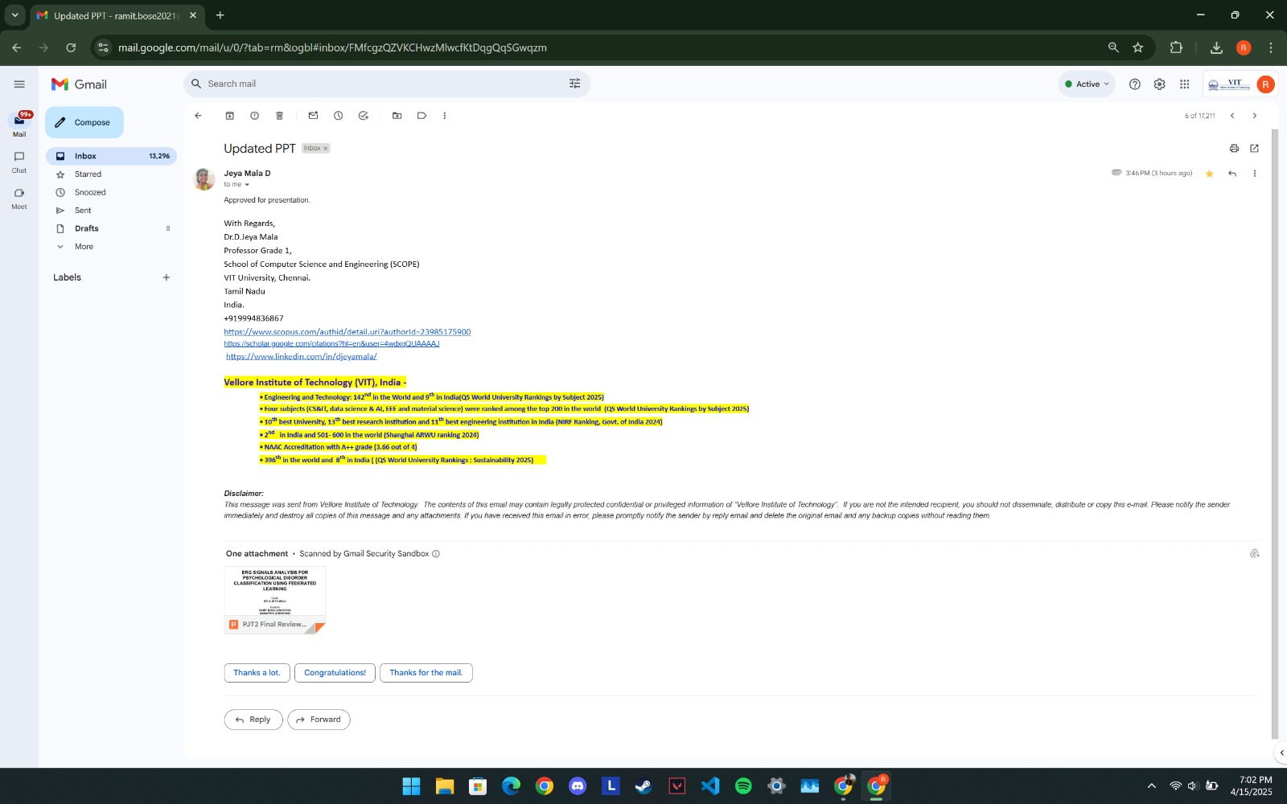
Guide Mail Approval

Slide 3
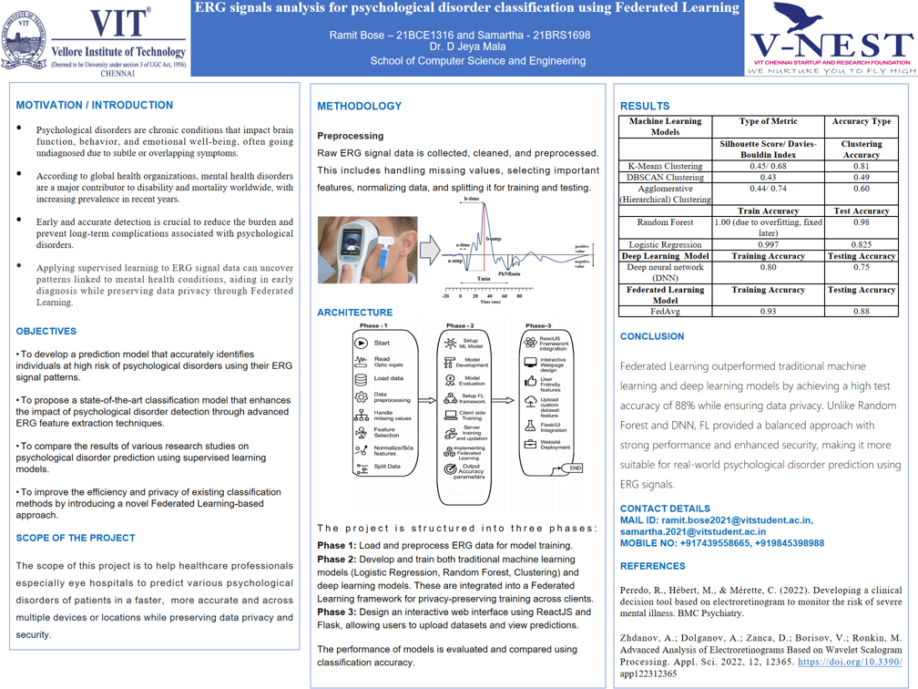

Slide 4
Introduction
The project focuses on ERG Signals Analysis for Psychological Disorder Classification Using Machine Learning and Deep Learning Models as an innovative approach to diagnosing mental health conditions like Schizophrenia, Depression, and Bipolar Disorder using Electroretinography (ERG) as a biomarker. A mobile application powered by advanced machine learning and deep learning algorithms processes ERG data for real-time, objective, and accurate diagnoses, bridging the gap between subjective assessments and physiological measurements. Future enhancements include integrating Federated Learning (FL) to improve diagnostic accuracy and global applicability by enabling secure training on diverse datasets from patients across various races and geographic regions while maintaining data privacy. This approach has the potential to transform psychiatric care by ensuring equitable, precise, and personalized mental health diagnostics worldwide.
a) Statement of Problem/Challenges (Research Question)
Traditional psychiatric diagnostics rely heavily on subjective symptom assessments, leading to potential delays or inaccuracies in diagnosing mental health disorders like schizophrenia, depression, and bipolar disorder. These methods lack objectivity and do not leverage quantifiable biological markers. Integrating Electroretinography (ERG) with advanced machine learning (ML) and deep learning (DL) techniques faces challenges in handling high-dimensional data, ensuring accurate classification, and maintaining data privacy in medical applications. Can federated learning (FL) enable decentralized and secure ERG-based diagnostics for psychological disorders while ensuring accuracy and practicality?
b) Background, Context, and Significance of Study
ERG is a non-invasive method for measuring retinal responses, reflecting brain activity and serving as a potential biomarker for neuropsychiatric disorders. Combining ERG analysis with ML and DL offers a transformative approach to mental health diagnostics by providing objective, quantifiable measures. The integration of federated learning addresses privacy concerns, enabling decentralized model training without compromising sensitive data. This research is significant in advancing objective psychiatric diagnostics, particularly among vulnerable populations like students, by fostering early intervention and better treatment outcomes while safeguarding privacy.

Slide 5
Literature Review
Reference No. | Authors | Themes Discovered in Review | Identification of Gaps based on Current Scenario/Industry Trends
[1] | Demmin, D. L., Roché, M., Davis, Q., & Silverstein, S. M. | Electroretinographic (ERG) Anomalies in Schizophrenia: The study identifies consistent anomalies in retinal cell function in schizophrenia patients, particularly in photoreceptor and bipolar cell signaling. Retinal Ganglion Cell Function: For the first time, the study examines retinal ganglion cell functioning using the photopic negative response (PhNR) of the ERG. Portable ERG Device: The study demonstrates that these anomalies can be detected using a portable hand-held ERG device, which opens up possibilities for more routine administration of ERG testing. | Limited Parameters Investigated: Several potentially important parameters have not yet been investigated, indicating a need for further research to explore these areas. Need for Broader Sample: The study's sample size is relatively small, and future research should include a larger and more diverse sample to validate the findings. Exploration of Neurotransmitter Changes: The study suggests that reduced signaling in retinal ganglion cells may be due to neurotransmitter changes, but this hypothesis needs further exploration.
[2] | Cabrera DeBuc, D., Somfai, G. M., Arthur, E., Kostic, M., Oropesa, S., & Mendoza Santiesteban, C. | Multimodal Diagnostic Eye Biomarkers: The study investigates the correlation between retinal vascular complexity and neurodegenerative changes in patients with cognitive impairment (CI) using a low-cost multimodal approach. Retinal Vascular and Neurogenic Changes: The study identifies significant alterations in the retinal microvascular network and functional loss in color vision in individuals with CI. Electroretinography (ERG) Findings: The study demonstrates that ERG can detect functional loss in the retina, which may be associated with cognitive decline. | Limited Sample Size: The study's sample size is relatively small, and future research should include a larger and more diverse sample to validate the findings. Need for Longitudinal Studies: The study is cross-sectional, and longitudinal studies are needed to investigate temporal and causal relationships between retinal changes and cognitive impairment. Exploration of Additional Retinal Parameters: The study suggests that other geometric vascular parameters and functional measures may be associated with cognitive decline and should be explored in future research.

Slide 6
Reference No. | Authors | Themes Discovered in Review | Identification of Gaps based on Current Scenario/Industry Trends
[3] | Cabrera DeBuc, D., Feuer, W. J., Persad, P. J., Somfai, G. M., Kostic, M., Oropesa, S., & Mendoza Santiesteban, C. | Vascular Complexity and Neurogenic Alterations: The study investigates the correlation between retinal vascular complexity and neurodegenerative changes in patients with cognitive impairment (CI) using a low-cost multimodal approach. Retinal Vascular and Neurogenic Changes: The study identifies significant alterations in the retinal microvascular network and functional loss in color vision in individuals with CI. Electroretinography (ERG) Findings: The study demonstrates that ERG can detect functional loss in the retina, which may be associated with cognitive decline. | Limited Sample Size: The study's sample size is relatively small, and future research should include a larger and more diverse sample to validate the findings. Need for Longitudinal Studies: The study is cross-sectional, and longitudinal studies are needed to investigate temporal and causal relationships between retinal changes and cognitive impairment. Exploration of Additional Retinal Parameters: The study suggests that other geometric vascular parameters and functional measures may be associated with cognitive decline and should be explored in future research.
[4] | Kazakos, C. T., & Karageorgiou, V. | Retinal Changes in Schizophrenia: The study identifies structural and functional changes in the retinal integrity of patients with schizophrenia, using noninvasive modalities like optical coherence tomography (OCT), electroretinography (ERG), and fundus photography. Diagnostic Accuracy: The study examines the diagnostic accuracy of these retinal evaluation methods, finding that while there are significant differences in retinal measurements between schizophrenia patients and controls, the diagnostic accuracy is limited. Potential Prognostic and Preventive Role: The study suggests that retinal evaluation could have potential prognostic, theranostic, and preventive roles in schizophrenia, although this remains to be further examined. | Limited Diagnostic Accuracy: The study finds that the diagnostic accuracy of retinal evaluation methods is limited, indicating a need for further research to improve these methods. Need for Longitudinal Studies: The study is cross-sectional, and longitudinal studies are needed to investigate the temporal and causal relationships between retinal changes and schizophrenia. Exploration of Additional Retinal Parameters: The study suggests that other retinal parameters and functional measures may be associated with schizophrenia and should be explored in future research.

Slide 7
Reference No. | Authors | Themes Discovered in Review | Identification of Gaps based on Current Scenario/Industry Trends
[5] | Constable, P. A., Ritvo, E. R., Ritvo, A. R., Lee, I. O., McNair, M. L., Stahl, D., Sowden, J., Quinn, S., Skuse, D. H., Thompson, D. A., & McPartland, J. C. | Electroretinographic (ERG) Differences in Autism Spectrum Disorder (ASD): The study identifies significant differences in light-adapted ERG responses between individuals with ASD and control subjects, particularly in the b-wave and a-wave amplitudes and peak times. Retinal Neurophysiology as a Biomarker: The study suggests that ERG could serve as a potential biomarker for ASD, providing insights into neural function and connectivity in the brain. Impact of Genetic and Environmental Factors: The study explores the role of genetic and environmental factors in modulating synaptic connectivity and neurotransmitter regulation in individuals with ASD. | Limited Sample Size and Diversity: The study's sample size is relatively small, and future research should include a larger and more diverse sample to validate the findings. Need for Longitudinal Studies: The study is cross-sectional, and longitudinal studies are needed to investigate temporal and causal relationships between retinal changes and ASD. Exploration of Additional Retinal Parameters: The study suggests that other retinal parameters and functional measures may be associated with ASD and should be explored in future research.
[6] | Lavoie, J., Maziade, M., & Hébert, M. | Flash Electroretinogram (ERG) as a Tool: The study explores the use of flash ERG to investigate psychiatric disorders, highlighting its potential as a non-invasive method to study brain functions indirectly. Retinal Anomalies in Psychiatric Disorders: The study identifies ERG anomalies in patients with psychiatric disorders such as seasonal affective disorder (SAD), schizophrenia, autism spectrum disorder (ASD), and drug addiction. Potential Biomarkers: The study discusses how changes in retinal functions might serve as biomarkers for psychiatric disorders and aid in diagnosis. | Need for Larger Sample Sizes: The study's sample sizes are relatively small, and future research should include larger and more diverse samples to validate the findings. Longitudinal Studies Required: The study is cross-sectional, and longitudinal studies are needed to investigate the temporal and causal relationships between retinal changes and psychiatric disorders. Exploration of Additional Retinal Parameters: The study suggests that other retinal parameters and functional measures may be associated with psychiatric disorders and should be explored in future research.

Slide 8
Reference No. | Authors | Themes Discovered in Review | Identification of Gaps based on Current Scenario/Industry Trends
[7] | Hébert, M., Mérette, C., Paccalet, T., Gagné, A.-M., & Maziade, M. | Electroretinographic (ERG) Anomalies in Major Depression: The study identifies significant ERG anomalies in patients with major depressive disorder (MDD), both medicated and drug-free, suggesting that these anomalies are inherent to the disorder. Impact of Medication: The study explores the impact of medication on ERG responses, finding that while some anomalies are present in both medicated and drug-free patients, certain ERG parameters may be normalized with medication. Neurodevelopmental Roots: The study suggests that the observed ERG anomalies in MDD patients may have neurodevelopmental origins, similar to those found in schizophrenia patients. | Need for Larger Sample Sizes: The study's sample sizes are relatively small, and future research should include larger and more diverse samples to validate the findings. Longitudinal Studies Required: The study is cross-sectional, and longitudinal studies are needed to investigate the temporal and causal relationships between ERG anomalies and major depressive disorder. Exploration of Additional Retinal Parameters: The study suggests that other retinal parameters and functional measures may be associated with major depressive disorder and should be explored in future research.
[8] | Silverstein, S. M., & Rosen, R. | Visual Processing Impairments in Schizophrenia: The study highlights various visual processing impairments in schizophrenia, including abnormalities in contrast sensitivity, color perception, and motion processing. Retinal and Ocular Changes: The study identifies multiple structural and functional disturbances in the eye, such as retinal venule widening, retinal nerve fiber layer thinning, and abnormal electroretinographic (ERG) amplitudes. Potential Biomarkers: The study suggests that certain retinal findings, like widened retinal venules and abnormal ERG amplitudes, can serve as biomarkers for schizophrenia and its progression. | Need for Larger Sample Sizes: The study's sample sizes are relatively small, and future research should include larger and more diverse samples to validate the findings. Longitudinal Studies Required: The study is cross-sectional, and longitudinal studies are needed to investigate the temporal and causal relationships between retinal changes and schizophrenia. Exploration of Additional Retinal Parameters: The study suggests that other retinal parameters and functional measures may be associated with schizophrenia and should be explored in future research.

Slide 9
Reference No. | Authors | Themes Discovered in Review | Identification of Gaps based on Current Scenario/Industry Trends
[9] | Peredo, R., Hébert, M., & Mérette, C. | Electroretinogram (ERG) as a Diagnostic Tool: The study explores the use of ERG to monitor the risk of severe mental illness (SMI), such as schizophrenia and bipolar disorder, highlighting its potential as a non-invasive method to study brain functions indirectly. High Sensitivity and Specificity: The study identifies that ERG shows very high sensitivity (91%) and specificity (89%) in distinguishing between SMI patients and healthy controls. Clinical Utility: The study demonstrates that ERG can be a useful clinical decision tool to monitor the risk of SMI and decide the course of action for at-risk individuals. | Need for Longitudinal Studies: The study is cross-sectional, and longitudinal studies are needed to investigate the temporal and causal relationships between ERG anomalies and SMI. Exploration of Additional Retinal Parameters: The study suggests that other retinal parameters and functional measures may be associated with SMI and should be explored in future research. Broader Sample Size: The study's sample size is relatively small, and future research should include a larger and more diverse sample to validate the findings.
[10] | Demmin, D. L., Roché, M., Davis, Q., & Silverstein, S. M. | Electroretinographic (ERG) Anomalies in Schizophrenia: The study identifies consistent anomalies in retinal cell function in schizophrenia patients, particularly in photoreceptor and bipolar cell signaling. Retinal Ganglion Cell Function: For the first time, the study examines retinal ganglion cell functioning using the photopic negative response (PhNR) of the ERG. Portable ERG Device: The study demonstrates that these anomalies can be detected using a portable hand-held ERG device, which opens up possibilities for more routine administration of ERG testing. | Limited Parameters Investigated: Several potentially important parameters have not yet been investigated, indicating a need for further research to explore these areas. Need for Broader Sample: The study's sample size is relatively small, and future research should include a larger and more diverse sample to validate the findings. Exploration of Neurotransmitter Changes: The study suggests that reduced signaling in retinal ganglion cells may be due to neurotransmitter changes, but this hypothesis needs further exploration.

Slide 10
Reference No. | Authors | Themes Discovered in Review | Identification of Gaps based on Current Scenario/Industry Trends
[11] | Alaql, A. M. | Electroretinographic (ERG) Signal Processing: The study focuses on various digital signal processing (DSP) techniques to analyze the ERG signal, such as Short Time Fourier Transform (STFT), Continuous Wavelet Transform (CWT), and Discrete Wavelet Transform (DWT). ERG Components: The research identifies and analyzes different components of the ERG signal, including a-wave, b-wave, i-wave, Photopic Negative Response (PhNR), and Oscillatory Potentials (OPs). ERG Models: The study uses mathematical models to represent the ERG response, particularly focusing on Castro's model for a-wave and b-wave. | Limited Sample Size: The study's sample size is relatively small, and future research should include a larger and more diverse sample to validate the findings. Need for Longitudinal Studies: The study is cross-sectional, and longitudinal studies are needed to investigate temporal and causal relationships between ERG anomalies and retinal disorders. Exploration of Additional DSP Techniques: The study suggests that other DSP techniques and algorithms could be explored to improve the accuracy and efficiency of ERG signal analysis.
[12] | Khalil, S. S., Tawfik, N. S., & Spruit, M. | Federated Learning in Mental Health: The study explores the potential of federated learning (FL) in mental health research, highlighting its ability to improve the detection, diagnosis, and treatment of mental disorders while preserving patient privacy. Privacy and Security: The study emphasizes the importance of privacy and security in mental health research, noting that FL allows multiple devices to train a shared model without exchanging raw data. Diverse Data Sources: The study reviews recent studies that have utilized FL in the psychiatric domain, covering multiple data resources and different machine-learning techniques. | Need for Standardization: The study identifies a lack of standardization in FL methodologies, which can hinder the reproducibility and comparability of results. Scalability Challenges: The study notes that scalability remains a challenge in FL, particularly when dealing with large and diverse datasets. Integration with Clinical Practice: The study suggests that more research is needed to integrate FL into clinical practice, ensuring that the technology can be effectively used by healthcare professionals.

Slide 11
Reference No. | Authors | Themes Discovered in Review | Identification of Gaps based on Current Scenario/Industry Trends
[13] | Hallaj, S., Chuter, B. G., Lieu, A. C., Singh, P., Kalpathy-Cramer, J., Xu, B. Y., Christopher, M., Zangwill, L. M., Weinreb, R. N., & Baxter, S. L. | Federated Learning in Glaucoma: The study explores the application of federated learning (FL) in glaucoma research, highlighting its potential to enhance the detection, diagnosis, and management of glaucoma while preserving patient privacy. Privacy and Security: The study emphasizes the importance of privacy and security in glaucoma research, noting that FL allows multiple institutions to collaborate without sharing raw data. Diverse Data Sources: The study reviews recent studies that have utilized FL in glaucoma research, covering multiple data sources and different machine-learning techniques. | Need for Standardization: The study identifies a lack of standardization in FL methodologies, which can hinder the reproducibility and comparability of results. Scalability Challenges: The study notes that scalability remains a challenge in FL, particularly when dealing with large and diverse datasets. Integration with Clinical Practice: The study suggests that more research is needed to integrate FL into clinical practice, ensuring that the technology can be effectively used by healthcare professionals.
[14] | Xu, J., Glicksberg, B. S., Su, C., Walker, P., Bian, J., & Wang, F. | Federated Learning in Healthcare: The study explores the application of federated learning (FL) in healthcare informatics, highlighting its potential to improve the detection, diagnosis, and treatment of various health conditions while preserving patient privacy. Privacy and Security: The study emphasizes the importance of privacy and security in healthcare research, noting that FL allows multiple institutions to collaborate without sharing raw data. Diverse Data Sources: The study reviews recent studies that have utilized FL in the healthcare domain, covering multiple data sources and different machine-learning techniques. | Need for Standardization: The study identifies a lack of standardization in FL methodologies, which can hinder the reproducibility and comparability of results. Scalability Challenges: The study notes that scalability remains a challenge in FL, particularly when dealing with large and diverse datasets. Integration with Clinical Practice: The study suggests that more research is needed to integrate FL into clinical practice, ensuring that the technology can be effectively used by healthcare professionals.

Slide 12
Reference No. | Authors | Themes Discovered in Review | Identification of Gaps based on Current Scenario/Industry Trends
[15] | Kumar, Y., & Singla, R. | Federated Learning in Healthcare: The study explores the application of federated learning (FL) in healthcare, highlighting its potential to improve the detection, diagnosis, and treatment of various health conditions while preserving patient privacy. Privacy and Security: The study emphasizes the importance of privacy and security in healthcare research, noting that FL allows multiple institutions to collaborate without sharing raw data. Diverse Data Sources: The study reviews recent studies that have utilized FL in the healthcare domain, covering multiple data sources and different machine-learning techniques. | Need for Standardization: The study identifies a lack of standardization in FL methodologies, which can hinder the reproducibility and comparability of results. Scalability Challenges: The study notes that scalability remains a challenge in FL, particularly when dealing with large and diverse datasets. Integration with Clinical Practice: The study suggests that more research is needed to integrate FL into clinical practice, ensuring that the technology can be effectively used by healthcare professionals.
[16] | Thummisetti, B. S. P., & Atluri, H. | Federated Learning in Healthcare: The study explores the transformative potential of federated learning (FL) in healthcare informatics, emphasizing its role in balancing advancements with privacy and security imperatives. Privacy and Security Mechanisms: The study highlights the importance of secure aggregation, differential privacy, and encryption protocols in FL to preserve data privacy. Practical Applicability: The study reviews real-world implementations and case studies, underscoring the practical applicability of FL in healthcare while addressing ethical implications and regulatory considerations. | Need for Standardization: The study identifies a lack of standardization in FL methodologies, which can hinder the reproducibility and comparability of results. Scalability Challenges: The study notes that scalability remains a challenge in FL, particularly when dealing with large and diverse datasets. Integration with Clinical Practice: The study suggests that more research is needed to integrate FL into clinical practice, ensuring that the technology can be effectively used by healthcare professionals.

Slide 13

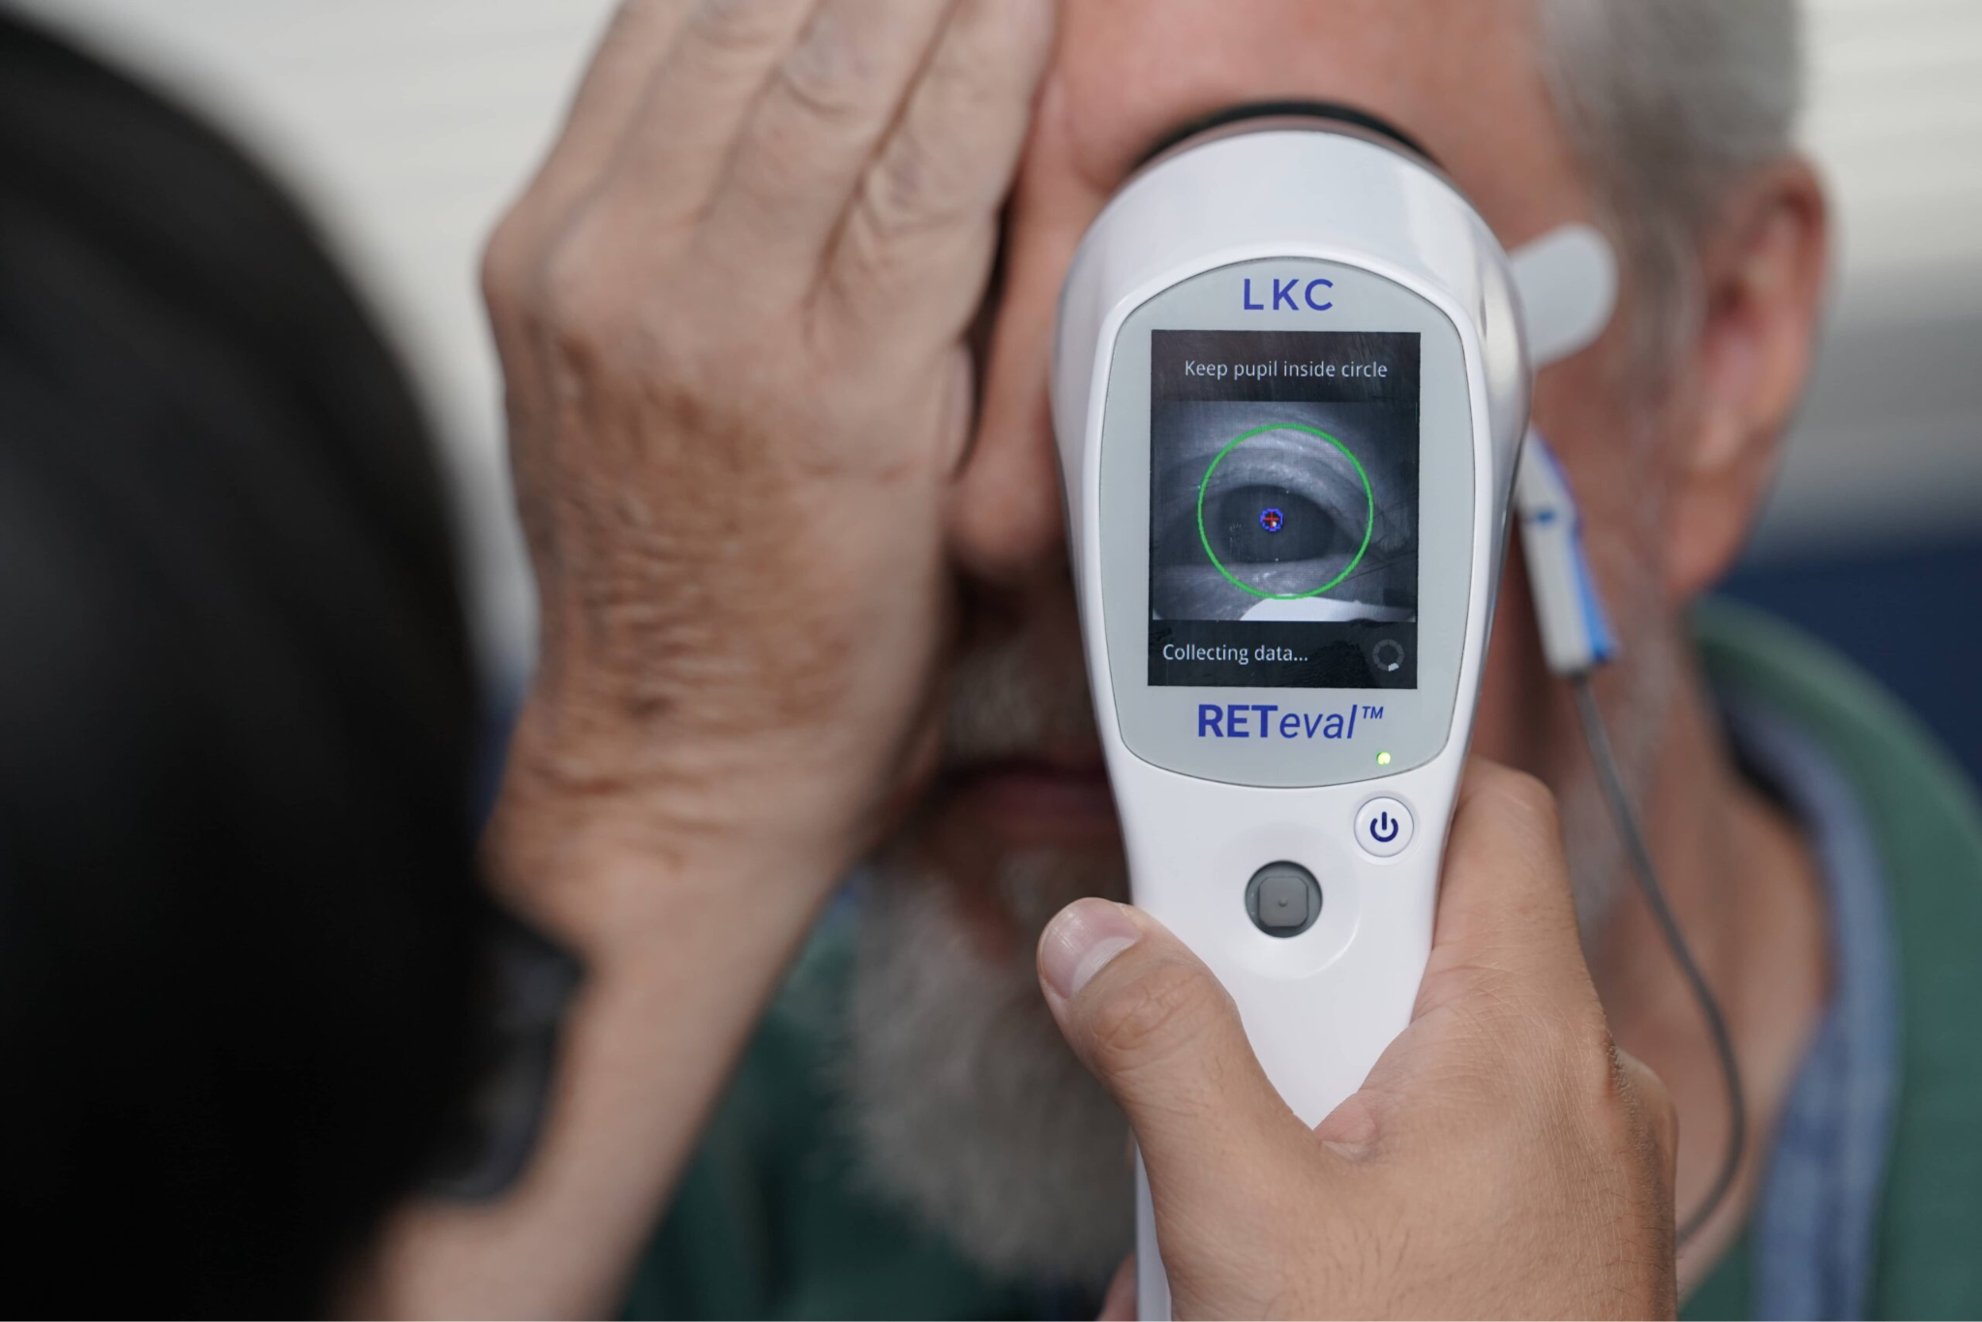
Problem Statement
Traditional diagnostic methods for mental illnesses like schizophrenia, depression, and bipolar disorder rely on subjective clinical interviews, leading to inconsistent signs, delayed, or incorrect diagnoses. Shared features among disorders further complicate precise identification and treatment. Electroretinography (ERG) offers a non-invasive biomarker linked to brain function, yet its application in psychiatry remains underdeveloped due to challenges like insufficient data for diagnostic correlations, lack of accuracy in capturing subtle retinal changes, and the need for advanced computational models to analyze high-dimensional ERG data. Developing an objective ERG-based diagnostic system, particularly for vulnerable groups like college students, is essential for early detection, personalized treatment, and improved mental health outcomes.
Subjective clinical interviews
Electroretinography

Slide 14
Research Challenges | Research Objective
ERG Signal Collection: Issues like signal noise, variability in quality, demographic diversity, and the lack of standardized protocols affect reliable data acquisition. Ethical and Logistical Constraints: Challenges in obtaining large datasets while ensuring patient consent and adhering to ethical guidelines. ML/DL Model Limitations: High-dimensional data complexity, overfitting risks, computational costs, and handling imbalanced datasets hinder model performance. Federated Learning Challenges: Data privacy concerns, decentralized collaboration issues, and scalability limitations impact global model training. Generalization and Validation: Ensuring models trained on diverse datasets accurately predict outcomes across populations while addressing overfitting and robustness. Clinical Integration: Aligning the system with clinical workflows, achieving regulatory approvals, and scaling for real-world use cases. | Reliable ERG Data Collection: Establish robust and standardized protocols for accurate and diverse ERG data acquisition. Accurate Diagnostic Models: Develop ML/DL models for precise psychological disorder classification using ERG data. Privacy and Security: Implement federated learning techniques to ensure privacy while utilizing distributed datasets. Scalable Frameworks: Design a federated system to integrate new devices and institutions for global applicability. Enhanced Generalization: Train models on diverse datasets to improve performance across demographics and regions. Real-Time Deployment: Create mobile and cloud-based platforms for real-time ERG analysis and diagnostic feedback.

Slide 15
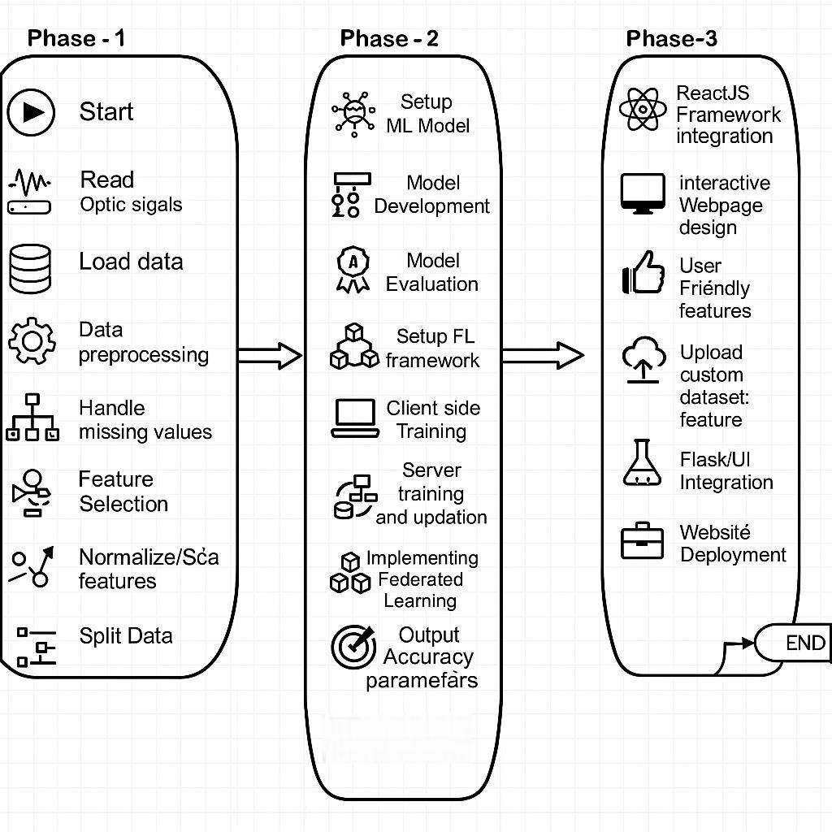
ARCHITECTURE DIAGRAM

Slide 16
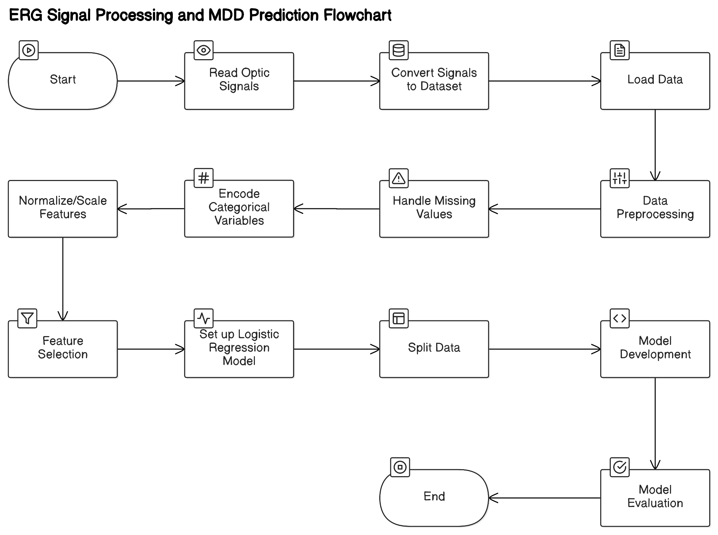
Methodology(Phase 1) - ERG data collection, Analysis and Mental Disorder Prediction using Machine Learning and Deep Learning Models

Slide 17
Methodology(Phase 2) - Implementing Federated Learning
Federated learning is a collaborative machine learning framework that allows multiple decentralized devices or institutions to train a shared model without exposing their local data. Unlike traditional centralized approaches, FL keeps raw data on local devices, transmitting only model updates to a central server. This ensures data privacy and security, which are critical in medical applications.
Key advantages of federated learning include:
Privacy Preservation: Sensitive ERG and mental health data remain on local servers, reducing the risk of breaches.
Scalability: FL enables the use of data from multiple institutions or devices without the need for data centralization.
Personalization: Local models can be fine-tuned to reflect individual or regional variations in data patterns.
By employing federated learning, this project seeks to overcome the limitations of existing centralized ML/DL models, ensuring compliance with privacy regulations while enhancing diagnostic accuracy.

Slide 18
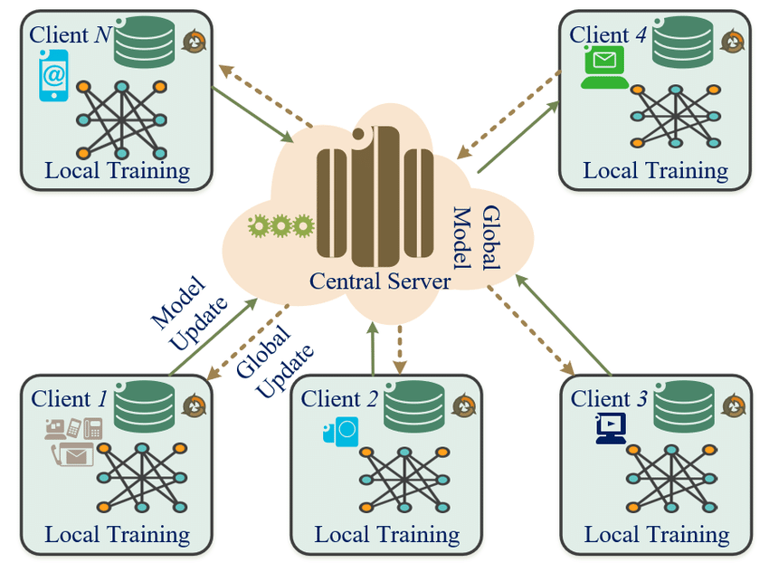
Design Diagram
The proposed methodology employs a federated learning framework to classify psychological disorders using ERG signals. Below is the design diagram illustrating the workflow of federated learning:

Slide 19
The Federated Learning (FL) architecture illustrated in this diagram can be effectively applied to your ERG signals project for psychological disorder classification. Below is an explanation of the workflow along with the local training and federated averaging equations tailored to your project:
Federated Learning Working for ERG-Based Project
Client Devices (Mobile Devices with ERG Handheld Devices):
Each client (mobile device) is equipped with an ERG device that captures the retinal electrical signals of patients.
A local deep learning (DL) model is used to preprocess the signals, extract features, and perform an initial classification to predict mental disorders such as depression, bipolar disorder, or schizophrenia.
If the accuracy of the local model is low, the parameters (weights and biases) are updated and sent to the central server for aggregation.
Central Server:
The central server acts as a coordinator to aggregate the updates (model parameters) sent by the clients.
It performs Federated Averaging (FedAvg) to combine the local model updates, fine-tunes the model through hyperparameter tuning, and redistributes the improved global model back to the clients.
Global Model Distribution:
After achieving a higher accuracy through centralized hyperparameter tuning and aggregation, the optimized global model is sent back to the clients.
The clients use the improved DL model to perform final predictions locally without sharing raw ERG data, thus maintaining patient privacy.

Slide 20
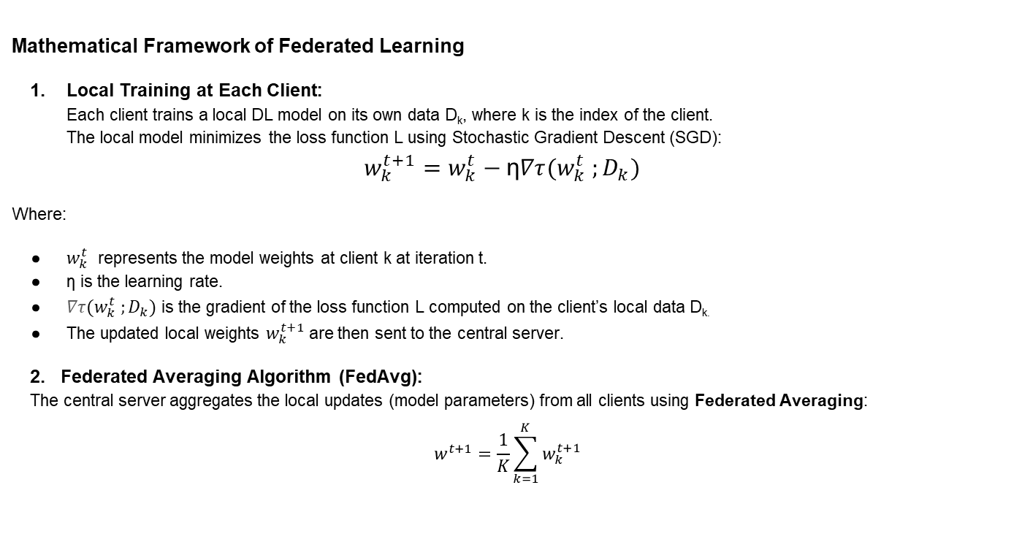
Mathematical Framework of Federated Learning
Local Training at Each Client: Each client trains a local DL model on its own data D_{k​}, where k is the index of the client. The local model minimizes the loss function L using Stochastic Gradient Descent (SGD):
$$w_{k}^{t+1}=w_{k}^{t}−\text{η}∇τ(w_{k}^{t} ;D_{k})$$
Where:
$w_{k}^{t}$ represents the model weights at client k at iteration t.
η is the learning rate.
$∇τ(w_{k}^{t} ;D_{k})$ is the gradient of the loss function L computed on the client’s local data D_{k.}
The updated local weights $w_{k}^{t+1}$are then sent to the central server.
2. Federated Averaging Algorithm (FedAvg): The central server aggregates the local updates (model parameters) from all clients using Federated Averaging:
$$w^{t+1}=\frac{1}{K}\sum_{k=1}^{K}{w_{k}^{t+1} }$$

Slide 21
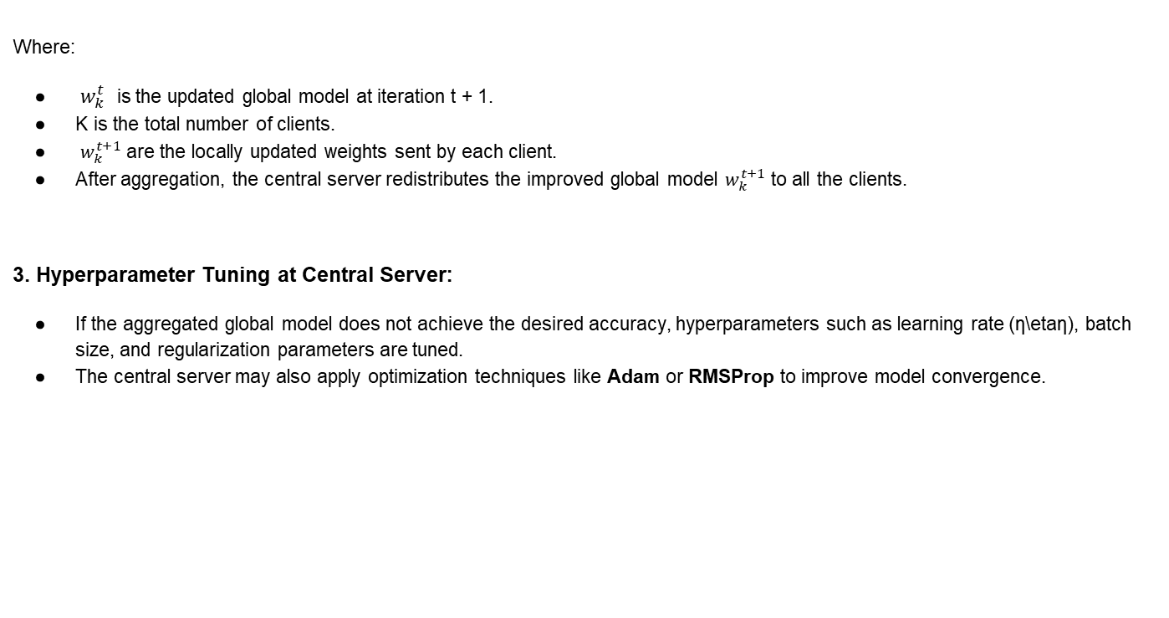
Where:
$w_{k}^{t}$ is the updated global model at iteration t + 1.
K is the total number of clients.
​ $w_{k}^{t+1}$ are the locally updated weights sent by each client.
After aggregation, the central server redistributes the improved global model $w_{k}^{t+1}$ to all the clients.
3. Hyperparameter Tuning at Central Server:
If the aggregated global model does not achieve the desired accuracy, hyperparameters such as learning rate (η\etaη), batch size, and regularization parameters are tuned.
The central server may also apply optimization techniques like Adam or RMSProp to improve model convergence.

Slide 22
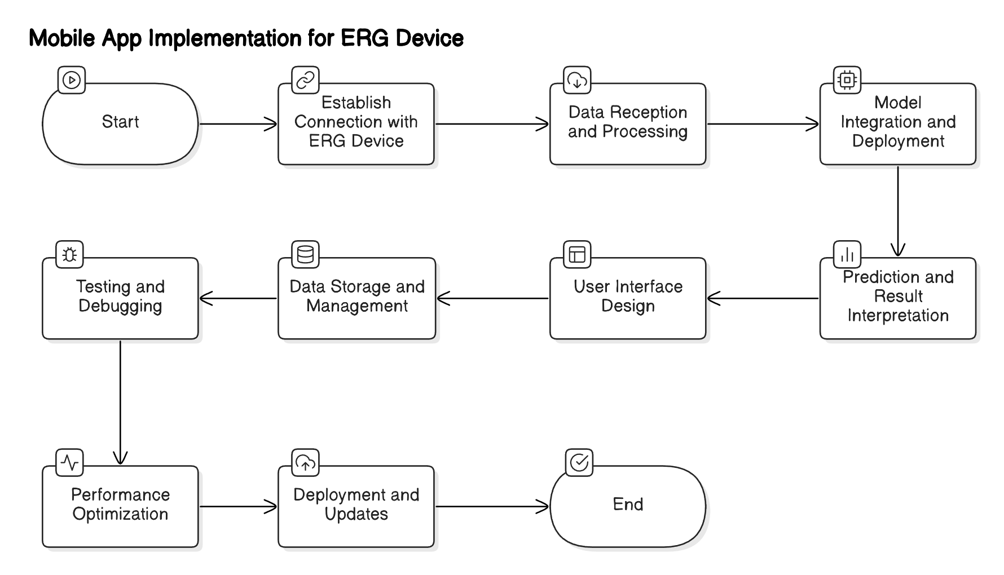
Methodology(Phase 3) - Integrating Web/ GUI based Application

Slide 23
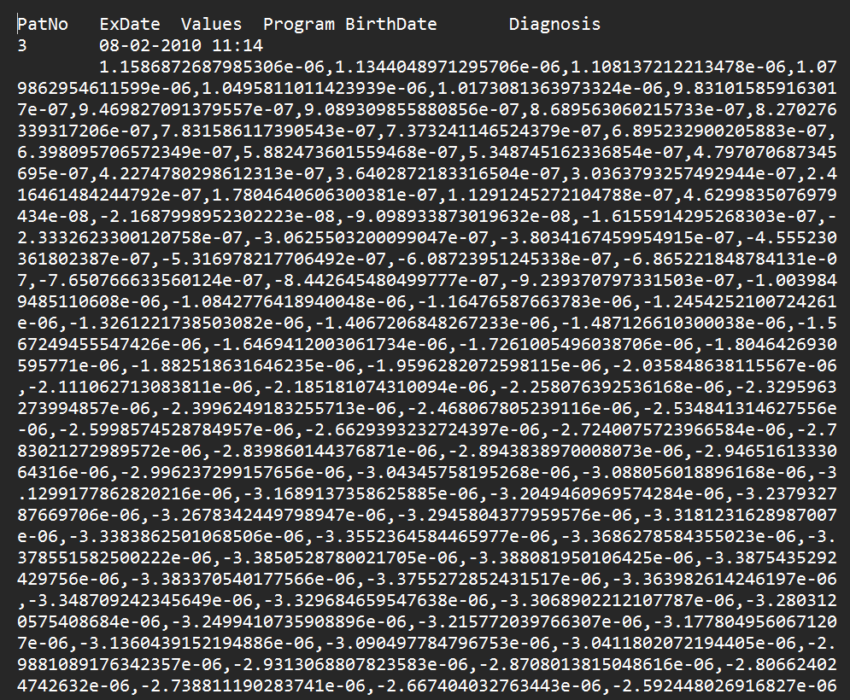
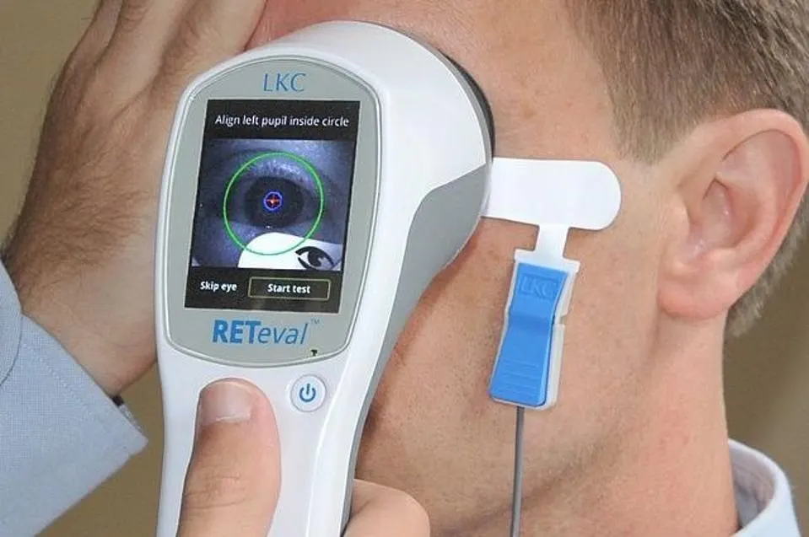
Data Collection Approaches/ Strategies
Proposed System(Phase 1.1) - ERG Data Collection
Captures continuous retinal signals from the patient's eye over time in microvolts and stores the raw data in .edf format.
Raw signals stored as .edf extension.
Note: EDF file is a European Data Format file, which is a standard file format for storing and exchanging biological and physical signals.

Slide 24
Processing ERG Raw Signals involves the following steps to convert them into processed data (in microvolts):
Data Acquisition:
Collect raw signals as voltage-time data (µV vs. ms) from retinal responses to light stimuli.
Baseline Correction:
Remove the pre-stimulus offset by subtracting the average signal before stimulus onset.
Filtering:
Apply a band-pass filter to retain frequencies relevant to ERG signals (e.g., 0.3 Hz to 300 Hz).
Remove noise (e.g., electrical interference, physiological artifacts).
Artifact Removal:
Exclude large spikes caused by eye movements or equipment issues using amplitude thresholds or automated detection.
Feature Extraction:
Identify key waveform components:
a-Wave: First negative trough (amplitude & latency).
b-Wave: First positive peak after the a-wave.
Oscillatory Potentials: Extract high-frequency components using further filtering.
Amplitude and Latency Measurements:
Measure amplitude (µV): Difference between trough/peak and baseline.
Measure latency (ms): Time from stimulus onset to a-wave or b-wave points.
The output is structured data with values like a-wave latency, b-wave amplitude, stored in tabular form for analysis.

Slide 25
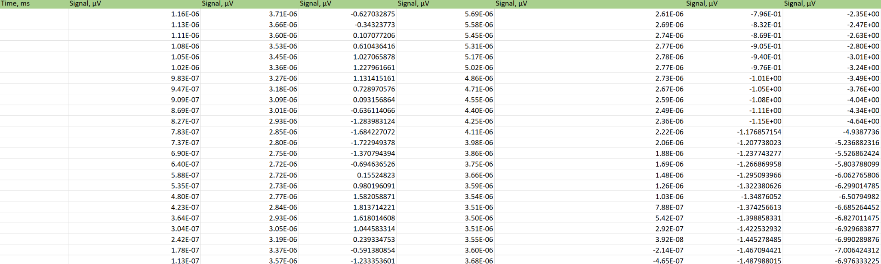
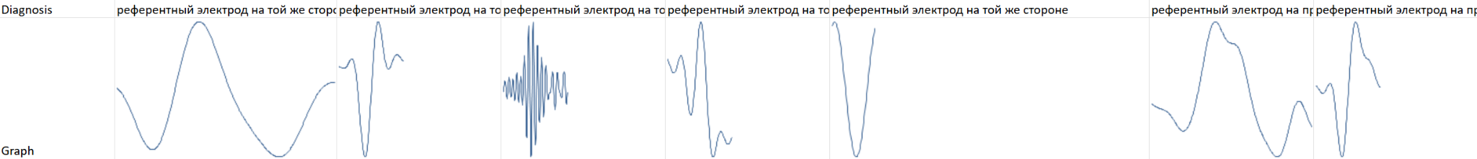
Here are the steps for converting .edf to .csv for all patients:
Install Required Libraries:
Install pyedflib and pandas: pip install pyedflib pandas
Load the .edf File:
Use pyedflib to read .edf files.
Extract metadata (e.g., signal labels, sampling rates).
Extract Data:
For each channel, read the signal data in microvolts.
Generate a time vector using the sampling rate.
Create a DataFrame:
Combine Patient ID, Signal Label, Time (s), and Voltage (µV) into rows.
Save as .csv:
Use pandas to save the extracted data as a CSV file.
Batch Processing (Optional):
Loop through multiple .edf files in a directory, append all data into one CSV file, and save.
Conversion of .edf (raw signals data) to readable .csv file
Plotting graph for all the microvolts values recorded over time for each patient

Slide 26
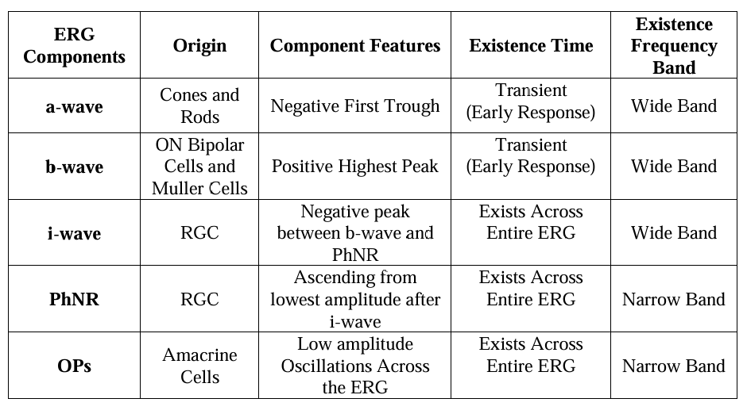
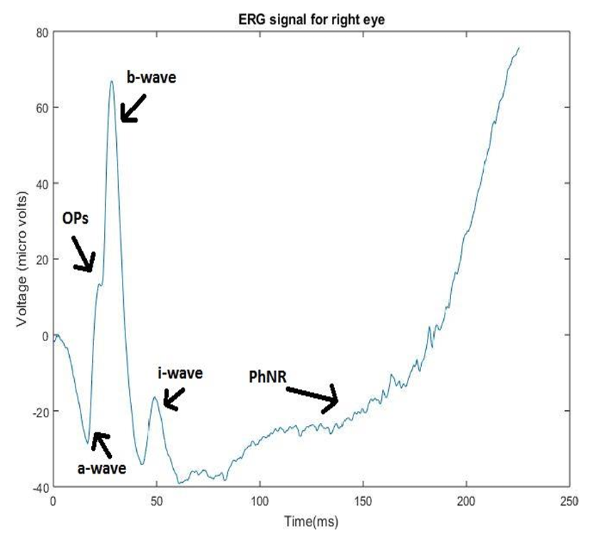
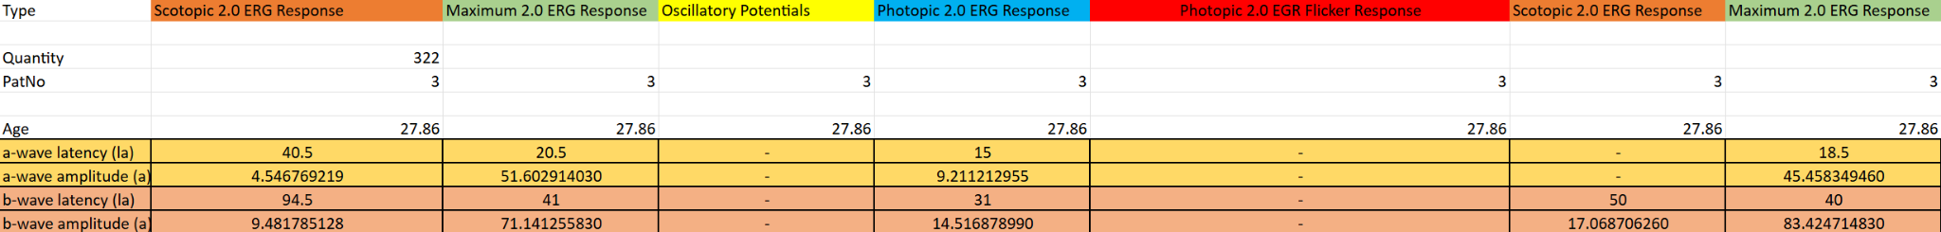
Finding out key values a-wave, b-wave, OPs, etc from the plotted graphs which are essential for analysis of psychological mental disorders of patients.

Slide 27
About the columns of the processed data:
1. Group
Description: Identifies the group or category to which the patient belongs.
Possible Values:
"Control" or "Normal" – for individuals without any diagnosed condition.
"Patient" or specific disease groups – for individuals with diagnosed conditions.
Significance: Helps in comparative studies or analysis across different cohorts.
2. Age
Description: The age of the individual at the time of examination.
Data Type: Integer or Float (if specific months or decimals are included).
Significance: Age is critical for assessing age-related changes in electrophysiological responses and for stratifying data.
3. Gender
Description: Biological gender of the individual.
Possible Values:
"M" or "Male"
"F" or "Female"
Significance: Used to analyze gender-related variations in ophthalmic electrophysiological responses.
4. Diagnosis
Description: The clinical diagnosis or condition of the individual.
Possible Values:
"Normal"
Specific disease or condition names (e.g., "Retinitis Pigmentosa", "Macular Degeneration").
Significance: Essential for linking signal data to pathological conditions and understanding disease-specific patterns.

Slide 28
5. Protocol
Description: The specific examination protocol or method used during data collection.
Possible Values:
"ISCEV-standard protocol" (or other specific protocols).
May include test names like "Full-Field ERG", "Pattern ERG".
Significance: Helps identify the methodology for standardizing and replicating studies.
6. Eye
Description: Specifies whether the recorded data corresponds to the right eye (OD), left eye (OS), or both.
Possible Values:
"OD" – Right eye.
"OS" – Left eye.
"OU" – Both eyes.
Significance: Differentiates between data collected from each eye, useful for asymmetric conditions.
7. Signal
Description: The electrophysiological signal data recorded during the test.
Data Type: Typically a numerical waveform or tabulated signal values.
Significance: Forms the basis of analysis for amplitude, latency, and other features.
8. Time
Description: The timepoints at which the signal was recorded, usually in milliseconds (ms).
Data Type: Numeric values, often in milliseconds.
Significance: Critical for assessing the timing of specific features in the waveform (e.g., peaks, troughs).
9. Amplitude
Description: The amplitude of the signal, often measured in microvolts (µV).
Data Type: Numeric.
Significance: Key parameter for evaluating the strength or response of the visual system.

Slide 29
Specific types of Electroretinography (ERG) responses, each associated with testing different functional aspects of the retina under varying conditions of light adaptation and stimulus characteristics.
1. Scotopic 2.0 ERG Response
Description: The ERG response recorded under scotopic (dark-adapted) conditions using a 2.0 cd·s/m² flash intensity.
Purpose:
Assesses rod photoreceptor function, which is primarily responsible for vision in low-light conditions.
Evaluates the activity of the rod system and associated bipolar cells.
Key Features:
Includes an a-wave (photoreceptor activity) and b-wave (post-receptoral activity, primarily rod bipolar cells).
Typically shows a high b-wave to a-wave amplitude ratio.
2. Maximum 2.0 ERG Response
Description: Also known as the "Combined Response," recorded under scotopic (dark-adapted) conditions with a brighter stimulus (2.0 cd·s/m² or similar).
Purpose:
Represents a combined response from both rod and cone systems.
Evaluates the overall retinal function, especially for conditions impacting both photoreceptor systems.
Key Features:
Produces robust a-wave (photoreceptor activity) and b-wave (bipolar and Müller cell activity).
3. Oscillatory Potentials (OPs)
Description: High-frequency wavelets superimposed on the ascending limb of the b-wave in the ERG.
Purpose:
Reflects inner retinal activity, particularly from amacrine cells in the inner plexiform layer.
Often used as an indicator of retinal ischemia or diabetic retinopathy.
Key Features:
Analyzed as a separate component from the standard ERG waveform.
Sensitive to retinal vascular and metabolic conditions.

Slide 30
4. Photopic 2.0 ERG Response
Description: The ERG response recorded under photopic (light-adapted) conditions using a 2.0 cd·s/m² flash intensity.
Purpose:
Assesses cone photoreceptor function, which is critical for daytime and color vision.
Helps evaluate conditions that primarily affect cones (e.g., cone dystrophies).
Key Features:
Produces prominent a- and b-waves, typically smaller than scotopic responses due to cone dominance.
5. Photopic 2.0 ERG Flicker Response
Description: The response recorded under photopic conditions using a flickering light stimulus, typically at 30 Hz or higher.
Purpose:
Assesses cone system temporal resolution and function.
Useful for diagnosing generalized cone dysfunction or assessing macular function.
Key Features:
Produces waveforms at the flicker frequency, with no a- or b-waves.
Sensitive to cone density and adaptability.
Clinical Significance
These parameters are part of the ISCEV (International Society for Clinical Electrophysiology of Vision) standard ERG tests, providing comprehensive insights into retinal health:
Scotopic Responses: Evaluate rod system and night vision.
Photopic Responses: Test cone system and day vision.
Oscillatory Potentials: Probe inner retinal activity, particularly amacrine cells.

Slide 31
Advantages, Limitations, Potential Risks and Ethical issues associated with the data collection Approach/ Strategy
Advantages of the Strategy High-Resolution Data: Capturing raw ERG signals allows detailed analysis, ensuring precise measurements of retinal responses. Standardization: Using .edf format ensures compatibility with various analytical tools and reproducibility of results. Longitudinal Study: Continuous signal data supports tracking changes over time for individual patients. Wide Applicability: Data can be reused for multiple research studies, enhancing its value. | Limitations of the Strategy Complex Processing: Requires advanced tools and expertise for filtering noise and extracting meaningful features. Storage Challenges: Raw signal data in .edf format demands significant storage capacity. Time-Consuming: Conversion and preprocessing steps are resource-intensive. Limited Generalizability: Small or localized datasets may not represent broader populations.
Potential Risks Data Loss: Improper handling of raw data could lead to corruption or loss, affecting analysis. Misinterpretation: Errors during processing may lead to inaccurate conclusions. Privacy Breach: If data is not anonymized, patient confidentiality could be compromised. | Ethical Issues Informed Consent: Ensuring participants understand how their raw ERG data will be used. Data Anonymization: Protecting participant identity during data sharing and publication. Bias in Sampling: Unintentionally excluding specific demographics may lead to inequitable research outcomes. Use Beyond Consent: Using data for purposes not agreed upon by participants could breach ethical standards.

Slide 32
Proposed System(Phase 1.2) - ERG Data Analysis
Detailed explanation about each column of the ISCEV (International Society for Clinical Electrophysiology of Vision) standard ERG Dataset:
id:
Description: A unique identifier for each participant or record in the dataset.
Relevance: Primarily used for data organization and tracking, not directly used in modeling.
Test:
Description: Indicates the type of electroretinography (ERG) test performed, such as LA3 (Light Adapted 3) or 30Hz.
Relevance: Different tests measure various aspects of retinal response; understanding which test was used is crucial as different tests may be associated with different physiological or psychological implications.
age:
Description: The age of the participant in years.
Relevance: Age is a critical factor in physiological and psychological health, as retinal responses can vary significantly across age groups.
Ethnic:
Description: A numerical code representing the participant’s ethnicity.
(1=Caucasian, 2=Asian, 3=Afro-Carribean, 4=Latino, 5=mixed)
Relevance: Ethnicity may influence retinal responses due to genetic factors affecting eye structure or function. This can also be related to genetic predispositions in mental health.
vert:
Description: Possibly a measure related to vertical eye function or positioning, though specifics are unclear without more context.
Relevance: Understanding vertical eye movement or positioning can provide insights into neuro-ophthalmological conditions which may correlate with certain psychological states.
iris:
Description: A numerical value likely associated with the iris, such as pigmentation or size.
Relevance: Iris features can influence light absorption and reflection, potentially affecting ERG results, which might indirectly relate to psychological factors like stress response.

Slide 33
Eye:
Description: Indicates which eye was tested (RightEye or LeftEye).
Relevance: Eye-specific data is important because conditions affecting one eye might not affect the other equally, which could be relevant for asymmetric neurological or psychological conditions.
a_time:
Description: The time measurement for a specific waveform component 'a' in the ERG response.
Relevance: The timing of ERG responses (like a-waves) can indicate retinal processing speed, which might be affected by mental health conditions such as depression or anxiety.
a_amp:
Description: Amplitude measurement for the 'a' component of the ERG waveform.
Relevance: Amplitude can reflect the strength of retinal responses, which might be diminished in various mental health conditions.
b_time:
Description: Time measurement for the 'b' component in the ERG response.
Relevance: Similar to a_time, b_time measures another critical part of the ERG response which can be linked to overall retinal and brain function.
b_amp:
Description: Amplitude measurement for the 'b' component.
Relevance: Amplitude here can reflect the functionality of the inner retina, which may relate to neurochemical changes linked to psychological health.
sex:
Description: A numerical code indicating the participant's sex (e.g., 0 for female, 1 for male).
Relevance: Sex can influence ERG responses due to hormonal or structural differences, which are also relevant to understanding sex-specific mental health trends.
OP_s_Amp:
Description: Amplitude of oscillatory potentials, which are rapid oscillations seen in ERG responses.
Relevance: OPs are associated with inner retinal activity and can be influenced by neurotransmitter levels, linking them to neurological and psychological conditions.
OP_s_Time:
Description: Time measurement for oscillatory potentials.
Relevance: Similar to other timing measures, this can reflect the speed of retinal processing, with potential links to cognitive function.

Slide 34
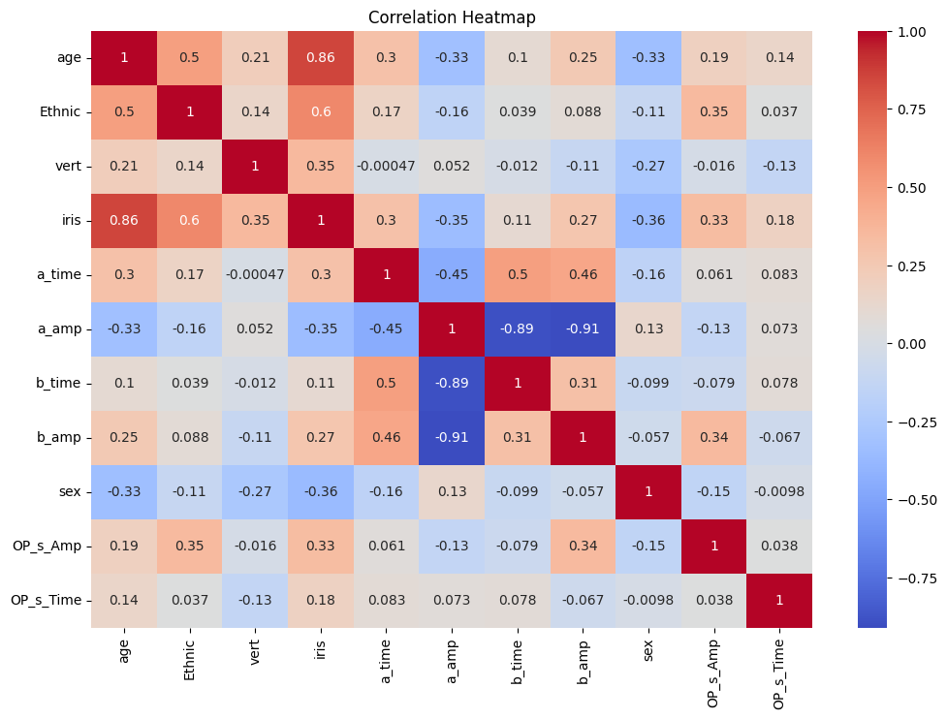
Data Visualization: Correlation Heatmap to identify which features might be less relevant

Slide 35
Feature Engineering
Essential Input Features for Predicting Mental Health: To predict what kind of mental health condition a student might be suffering from using machine learning models based on electroretinography (ERG) data, the input parameters (features) should be those that have a direct or significant association with mental health indicators. Here's a refined list of essential input features:
a_time:
Description: The timing of the a-wave component in the ERG, reflecting the speed of photoreceptor response.
Relevance: Delays in a-wave timing can be linked to conditions like depression and anxiety.
a_amp:
Description: The amplitude of the a-wave, indicating the strength of the photoreceptor response.
Relevance: Changes in amplitude can correlate with neurological function and certain mental health conditions.
b_time:
Description: The timing of the b-wave component, related to the activity of the inner retina (bipolar and Müller cells).
Relevance: Alterations in b-wave timing may indicate broader neurological impacts associated with mental health.
b_amp:
Description: The amplitude of the b-wave, which reflects the overall response of the inner retina.
Relevance: Reduced amplitudes can be indicative of dysfunction in inner retinal processing linked to mental health issues.
OP_s_Amp:
Description: The amplitude of oscillatory potentials, related to inner retinal and neurotransmitter activity.
Relevance: Changes in oscillatory potentials are linked to neurotransmitter imbalances seen in conditions like schizophrenia and mood disorders.
OP_s_Time:
Description: The timing of oscillatory potentials.
Relevance: Timing variations can indicate changes in retinal processing speeds associated with neurological health.
age:
Description: Age of the student.
Relevance: Age is a crucial factor as mental health and retinal responses can vary significantly across different ages.
sex:
Description: Biological sex of the student (e.g., male or female).
Relevance: Sex differences can affect both mental health prevalence and retinal response patterns.

Slide 36
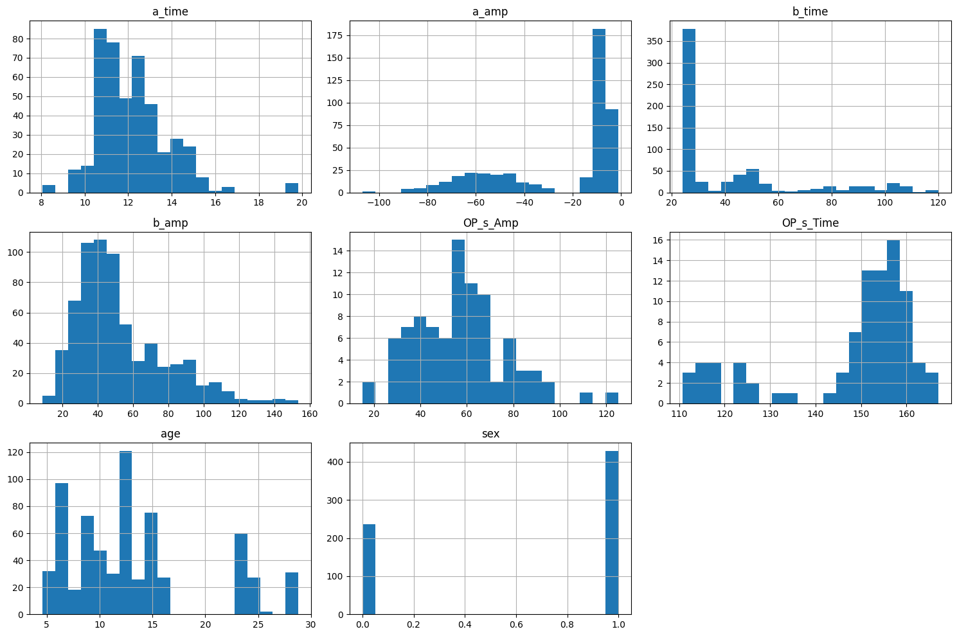
Data Visualization: Histogram for each input feature

Slide 37
Data Preprocessing
Removing Null Values
Working with the Relevant Input Features for the Mental Disorder Classification
Adding Target Columns:
Psychiatric Disorder
1. Major Depression Disorder (MDD) 2. Seasonal Affective Disorder (SAD) 3. Schizophrenia (SZ) 4. Bipolar Disorder (BD) 5. Autism spectrum disorders (ASD) 6. Drug Addiction (DA)
7. High genetic Risk for children Column for SZ or BD (High_Risk_SZ_BD)
Risk (0=low, 1=medium, 2=high)
Low (0): Minor deviations in features, likely normal variations.
Medium (1): Moderate deviations suggesting early or mild mental health issues.
High (2): Significant deviations across multiple features, indicating severe mental health risks.

Slide 38
Conditions for determining Mental Disorders
Psychiatric Disorder | Disorder Type of ERG | ERG Anomalies Observed in Patients
Seasonal Affective Disorder (SAD) | Mixed rod and cone response | Lower b-wave amplitude in wintertime (men and women together)
 |  | Shorter b-wave implicit time in wintertime (only in men)
 | Rod response | Decrease in rod retinal sensitivity in wintertime and normalization in summertime (S-SAD)
 | Rod response | Lower T50µV (referring to retinal sensitivity) in wintertime
 | Cone response | Lower b-wave Vmax amplitude in wintertime
 |  | Prolonged b-wave implicit time in wintertime
 | Rod response | Decrease in retinal sensitivity in wintertime
Schizophrenia (SZ) | Cone response | Decrease in b-wave amplitude (untreated patients)
 | Cone response | Lower a-wave amplitude (medicated patients)
 |  | Lower a-wave amplitude only (1 patient medication-free for over 6 months)
 | Rod response | Lower a- and b-wave amplitudes (medicated patients)
 | Cone response | Lower a-wave amplitude during the acute stage of the illness and not after 8 weeks of treatment (stabilized medicated patients)
 | Cone and rod response | No ERG anomaly was distinguished (patients' medication-free for 2 weeks)
Bipolar Disorder (BD) | Cone response | No ERG anomaly was observed (medicated patients)
Children at High Genetic Risk for SZ or BD | Rod response | Lower b-wave Vmax amplitude
 |  | Trend for a longer b-wave implicit time at Vmax
 | Cone response | Trend for a lower a-wave amplitude
Autism Spectrum Disorders (ASD) | Scotopic dim blue and dim red light stimulation | Lower b-wave amplitude in 48% of the ASD subjects
Drug Addiction (DA) | Blue cone ERG | Lower b-wave amplitude in 50% of the withdrawn cocaine-dependant subjects

Slide 39
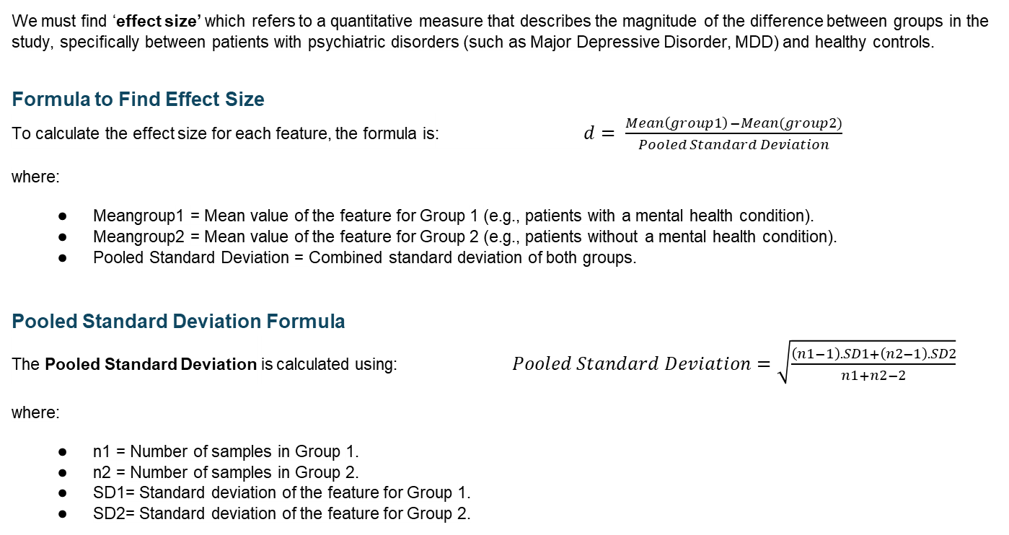
Effect Size for finding out Major Depressive Disorder (MDD)
We must find ‘effect size’ which refers to a quantitative measure that describes the magnitude of the difference between groups in the study, specifically between patients with psychiatric disorders (such as Major Depressive Disorder, MDD) and healthy controls.
Formula to Find Effect Size To calculate the effect size for each feature, the formula is: $d= \frac{Mean\left(group1\right) −Mean(group2)}{Pooled Standard Deviation}$
where:
Meangroup1 = Mean value of the feature for Group 1 (e.g., patients with a mental health condition).
Meangroup2 = Mean value of the feature for Group 2 (e.g., patients without a mental health condition).
Pooled Standard Deviation = Combined standard deviation of both groups.
Pooled Standard Deviation Formula The Pooled Standard Deviation is calculated using: $Pooled Standard Deviation=\sqrt{\frac{\left(n1−1\right).SD1+\left(n2−1\right).SD2}{n1+n2−2}}$
where:
n1 = Number of samples in Group 1.
n2 = Number of samples in Group 2.
SD1= Standard deviation of the feature for Group 1.
SD2= Standard deviation of the feature for Group 2.

Slide 40
Normal Values for Each Feature:
a_time (ms):
Normal: Approximately 10-14 ms
Abnormal (suggesting disorder): Prolonged > 14 ms
a_amp (µV):
Normal: Typically 30-50 µV
Abnormal: Reduced significantly below 20 µV
b_time (ms):
Normal: Approximately 20-30 ms
Abnormal: Prolonged > 30 ms
b_amp (µV):
Normal: Usually 90-120 µV
Abnormal: Reduced < 70 µV
OP_s_Amp (µV):
Normal: Typically 10-20 µV
Abnormal: Reduced < 10 µV
OP_s_Time (ms):
Normal: Around 14-20 ms
Abnormal: Prolonged > 20 ms
age (years):
Normal: No direct link with disorder purely based on age but generally assessments are more frequent in adults over 18.
Children and elderly may have different normal values due to developmental and aging factors.
sex (0 = Male, 1 = Female):
No direct implication of sex on normal ERG values, but some differences may exist in ERG responses between males and females.

Slide 41
ERG Suicidal Risk conditions
Based on the research paper and additional sources, here are the conditions for High, Medium, and Low Risks of Suicidal Behaviour for the input features:
High Risk
a_time: Significantly lower than normal.
a_amp: Normal amplitude.
b_time: Increased implicit time and latency.
b_amp: Reduced amplitude.
OP_s_Amp: Decreased or completely extinguished.
OP_s_Time: Increased implicit time.
Medium Risk
a_time: Slightly lower than normal.
a_amp: Normal amplitude.
b_time: Slightly increased implicit time and latency.
b_amp: Slightly reduced amplitude.
OP_s_Amp: Decreased but not extinguished.
OP_s_Time: Slightly increased implicit time.
Low Risk
a_time: Normal.
a_amp: Normal amplitude.
b_time: Normal implicit time and latency.
b_amp: Normal amplitude.
OP_s_Amp: Normal.
OP_s_Time: Normal implicit time.
These conditions are derived from the findings that individuals with suicidal behaviors often exhibit specific changes in their electroretinography (ERG) readings, such as reduced b-wave amplitude and increased implicit time

Slide 42
Proposed System(Phase 1.3) - Applying various Machine Learning algorithms on the Modified Dataset
Classification Algorithms:
Random Forest Classifier with target column
Logistic Regression with target column
Clustering Algorithms:
K-Means (accuracy=0.65) without target column
DBSCAN (accuracy=0.81) without target column
Agglomerative (Hierarchical) without target column

Slide 43
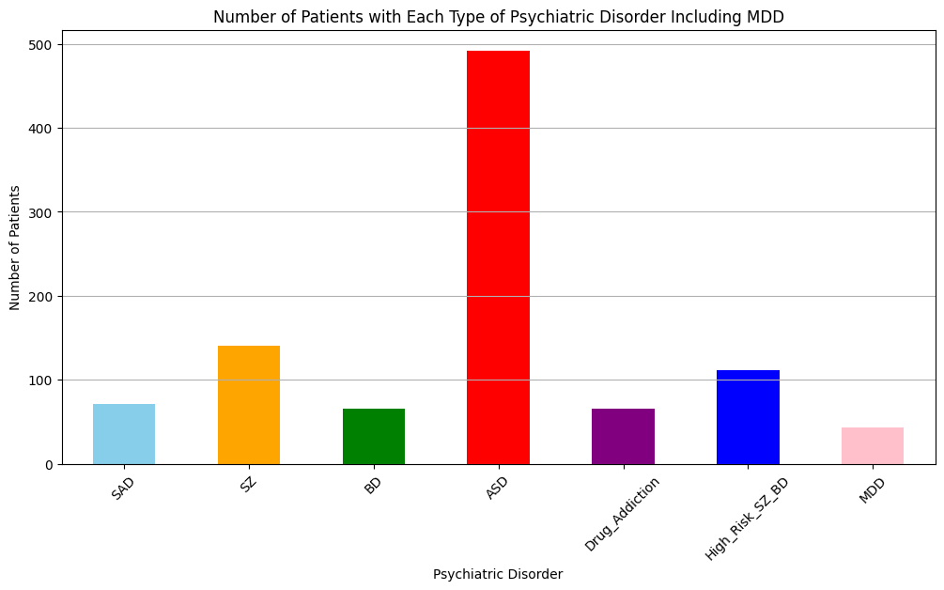
Using Random Forest and Logistic Regression the model was trained and tested:

Slide 44
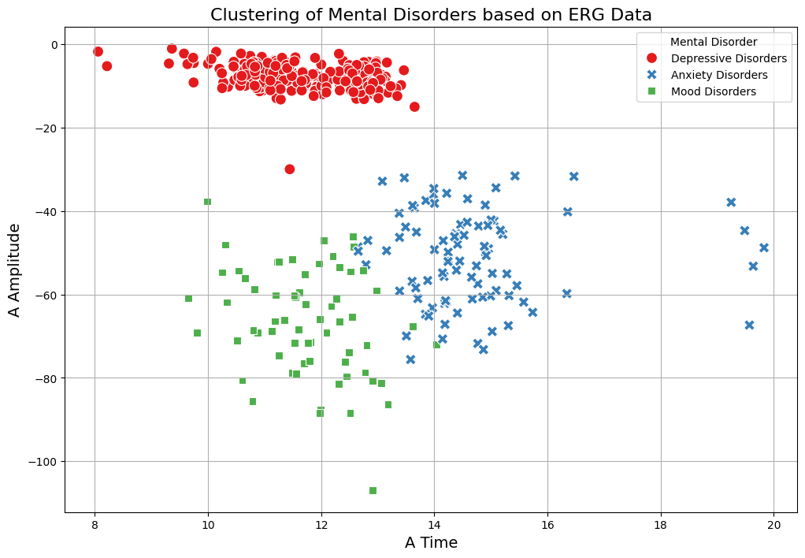
K-Means Clustering

Slide 45
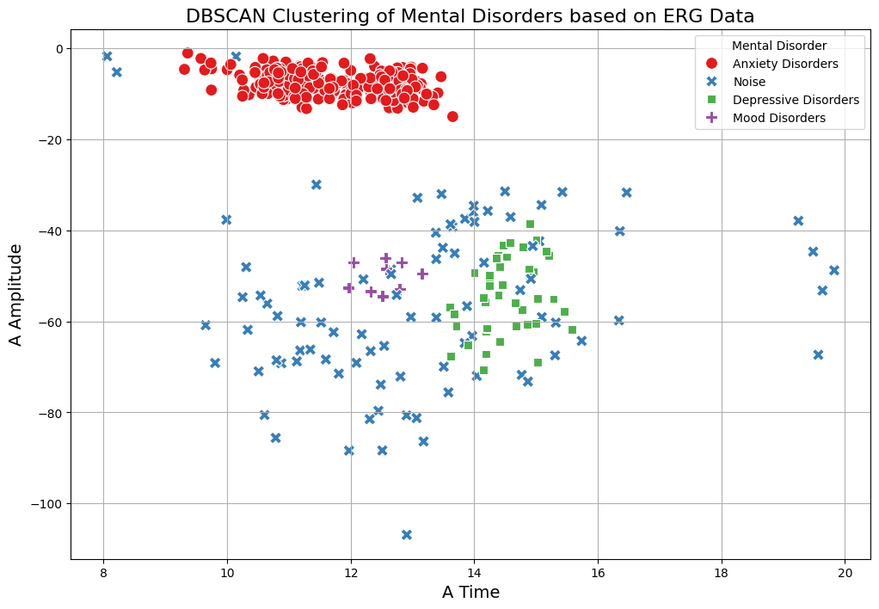
DBSCAN Clustering

Slide 46
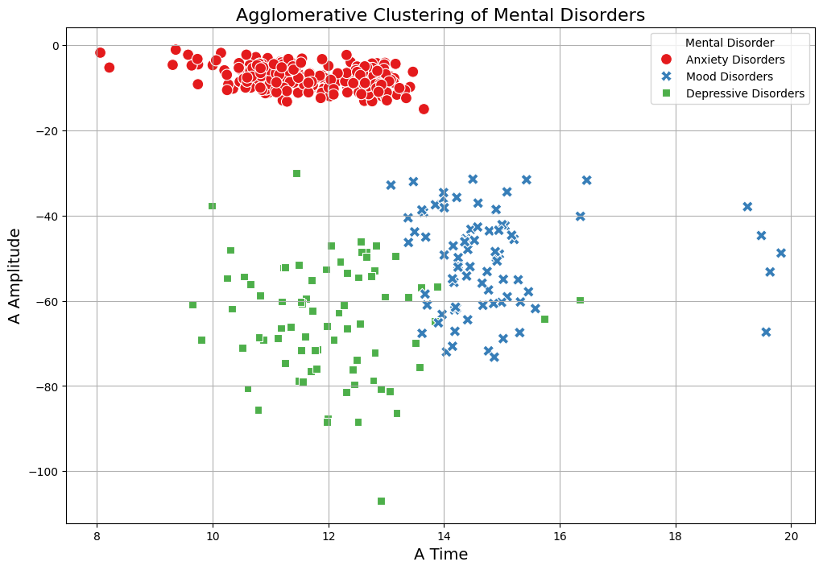
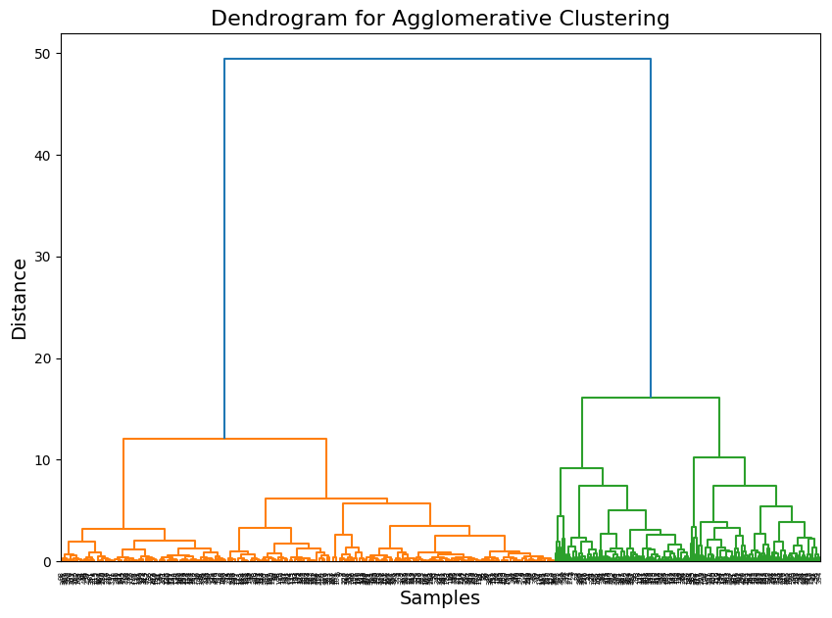
Agglomerative Clustering (Hierarchical)

Slide 47
Proposed System(Phase 1.4) - Applying Deep-Learning Algorithm for achieving higher level of accuracy
The code uses a feedforward neural network, which is a type of Deep Neural Network (DNN). This model is built using Keras' Sequential API and contains multiple layers of neurons organized in a simple sequence. Here's a breakdown of the architecture and deep learning algorithm used:
Deep Learning Algorithm: Feedforward Neural Network (DNN)
Model Structure: This is a fully connected, feedforward neural network. Each neuron in a layer is connected to every neuron in the following layer. Information flows forward from the input layer, through hidden layers, to the output layer without any cycles or backward connections.
Architecture:
Input Layer: The input layer has 8 features (Age, Sex, a_time, a_amp, b_time, b_amp, OP_s_Amp, and OP_s_Time).
Hidden Layers:
The first hidden layer has 64 neurons with ReLU (Rectified Linear Unit) as the activation function.
The second hidden layer has 32 neurons with ReLU activation.
Output Layer: The output layer has 5 neurons, corresponding to each class in the Mental_Disorder target variable. The activation function is softmax, which outputs probabilities for each class and is used for multi-class classification.

Slide 48
Key Elements of the Model
Activation Functions:
ReLU: Used in hidden layers to introduce non-linearity, helping the model capture complex patterns.
Softmax: Used in the output layer to provide a probability distribution across the classes, suitable for multi-class classification.
Loss Function:
Sparse Categorical Crossentropy: This loss function is appropriate for multi-class classification problems where the target labels are integer-encoded. It computes the cross-entropy loss between the true labels and predicted probabilities.
Optimizer:
Adam Optimizer: A popular choice for deep learning models due to its adaptive learning rate properties, which help accelerate convergence during training.
Summary
This deep learning algorithm is a Deep Neural Network (DNN) with fully connected (dense) layers. It’s designed for multi-class classification, making it suitable for predicting different mental disorders based on the input features. The training involves forward propagation and backpropagation to adjust weights and minimize the loss function over multiple epochs, ultimately aiming to classify patients into one of the predefined mental disorder categories.

Slide 49
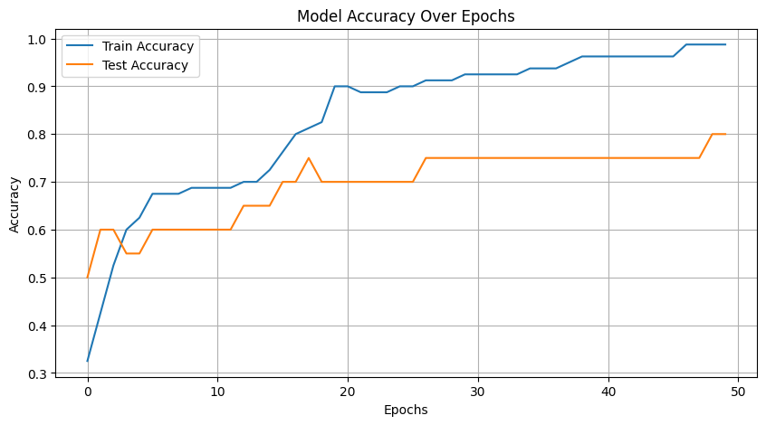
Training and Testing the Deep-Learning model
Train Accuracy: 0.95 - 0.99 Test Accuracy: 0.75 - 0.80

Slide 50
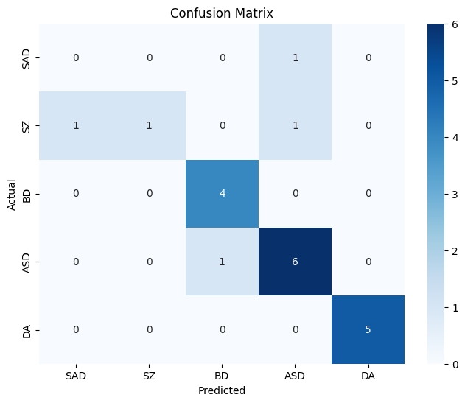
Confusion Matrix

Slide 51
Predicting Mental Disorder for new Patient Data
Patient Data 1: 'Age': 30, 'Sex': 0, 'a_time': 256, 'a_amp': 5.41813E-06, 'b_time': 256, 'b_amp': 5.41813E-06, 'OP_s_Amp': -3.95599E-09, 'OP_s_Time': 496
DL Model Prediction: Autism Spectrum Disorder (ASD)
Patient Data 2: 'Age': 40, 'Sex': 1, 'a_time': 177, 'a_amp': 2.03963E-05, 'b_time': 177, 'b_amp': 2.03963E-05, 'OP_s_Amp': -1.77914E-09, 'OP_s_Time': 501
DL Model Prediction: Schizophrenia (SZ)

Slide 52
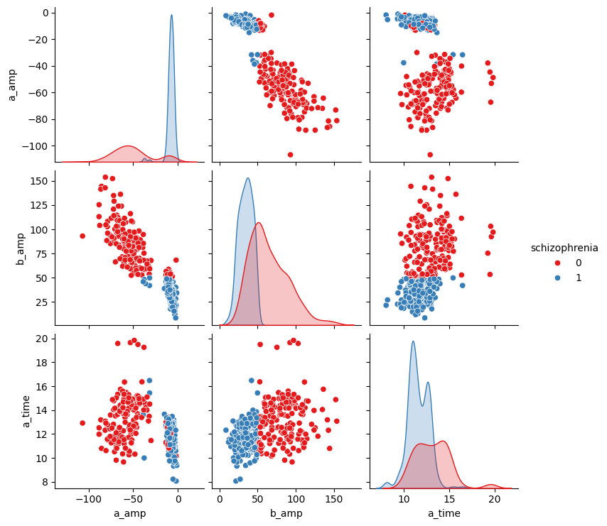
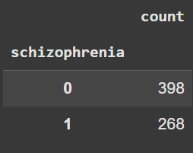
Schizophrenia: Pairplot against each input feature

Slide 53
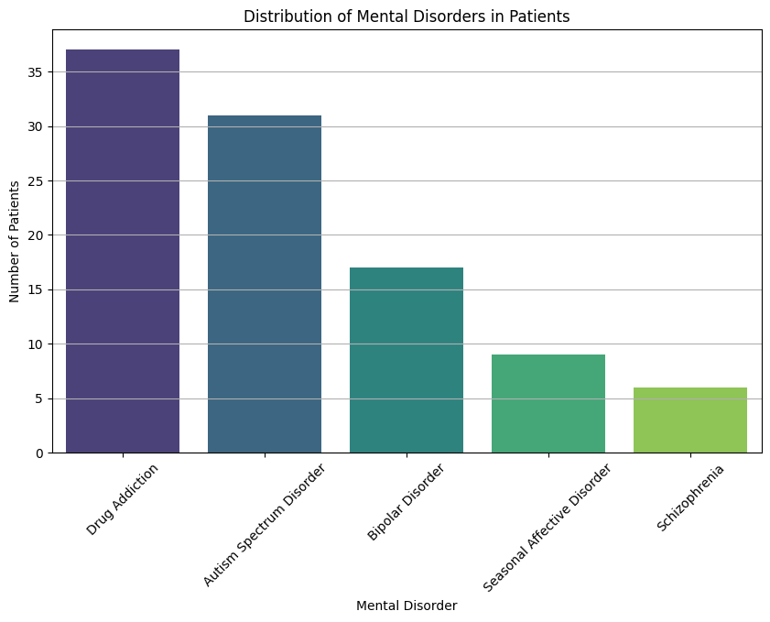
The Deep-Learning model finds the number of patients in each Mental Disorder

Slide 54
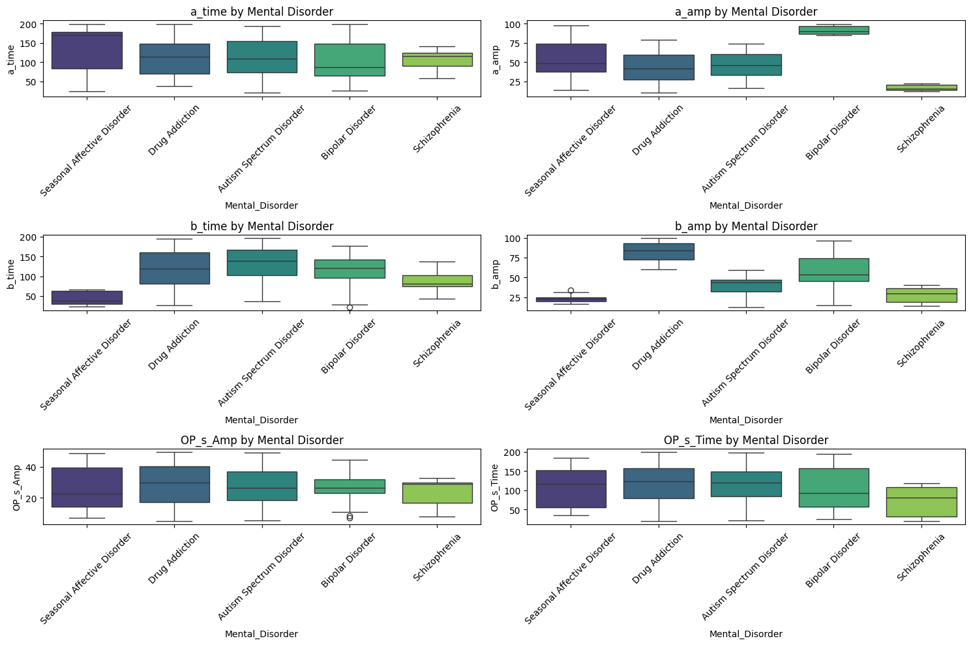
Relationship with individual Feature: Boxplot

Slide 55
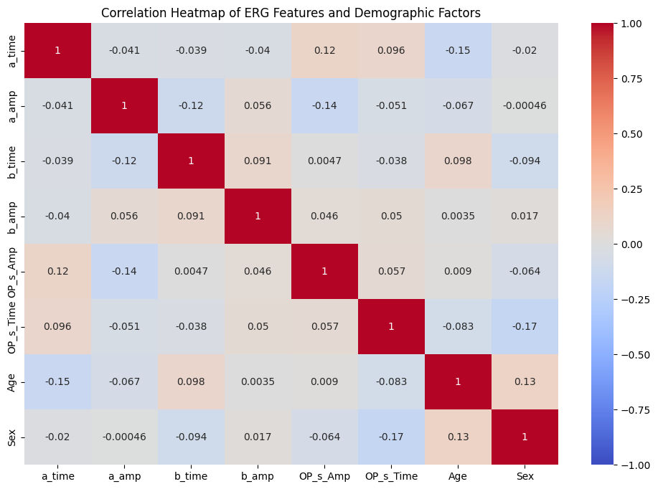

Slide 56
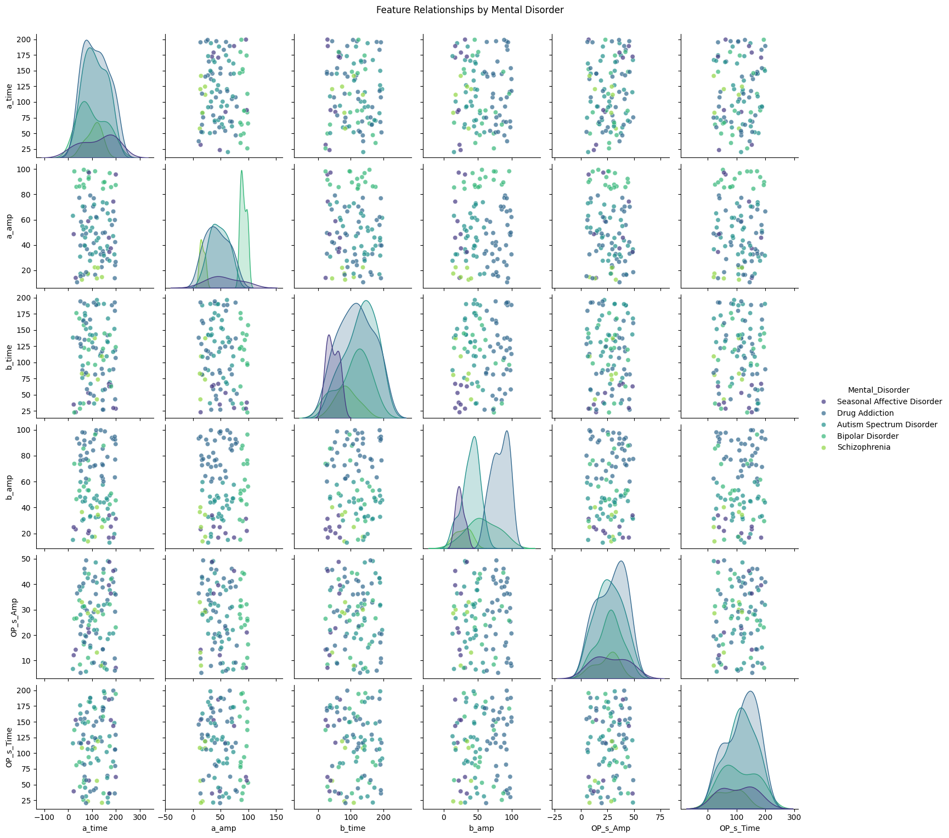
Feature Relationship by Mental Disorder: PairPlot

Slide 57
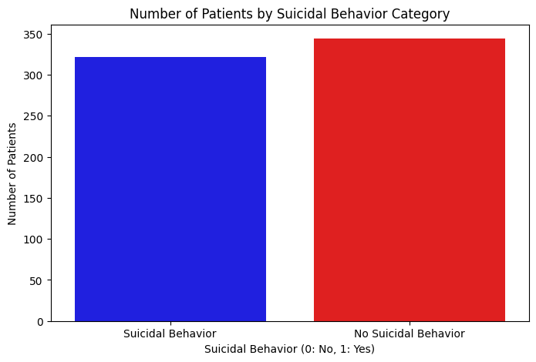
Suicidal Behaviour Analysis:

Slide 58
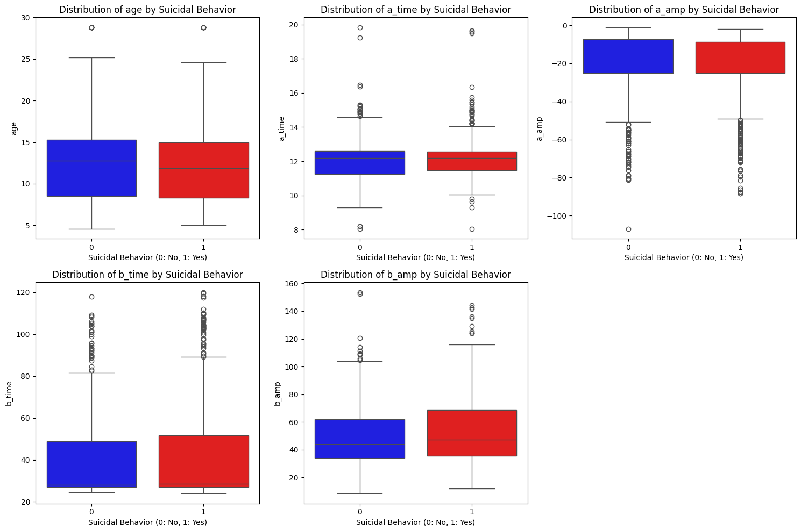
Suicidal Behaviour Analysis with respect to each feature:

Slide 59
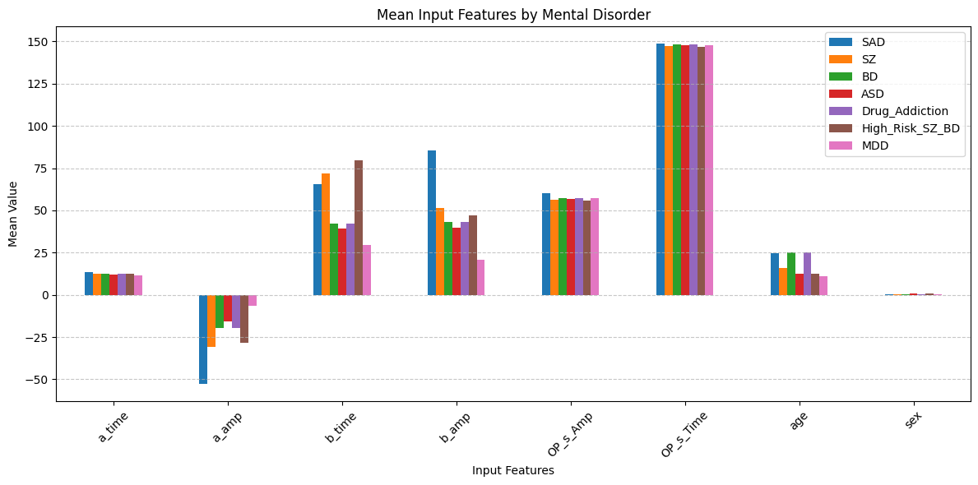

Slide 60
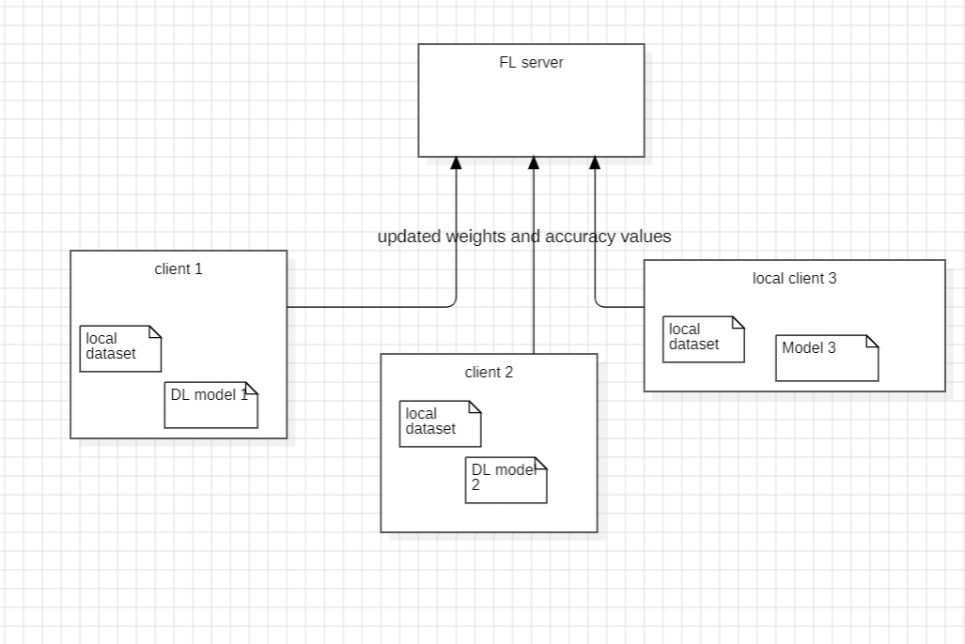
Proposed System(Phase 2) - Implementing Federated Learning
How Federated Learning Works
1. Initialization: A global model is initialized or an existing model is chosen to start with.
2. Local Training: Each client (device) trains a copy of the model using its own private data. These local models are updated by learning from local data.
3. Model Updates: Each client sends its model updates (not the raw data) to a central server. This may include gradients or adjusted model weights derived from local training.
4. Aggregation: The central server aggregates the updates from all clients to build a more accurate global model. A common aggregation technique is Federated Averaging (FedAvg), where the average of the model updates is taken to form the global model.
5. Iteration: Steps 2-4 are repeated for several rounds until the global model has achieved a satisfactory level of performance.

Slide 61
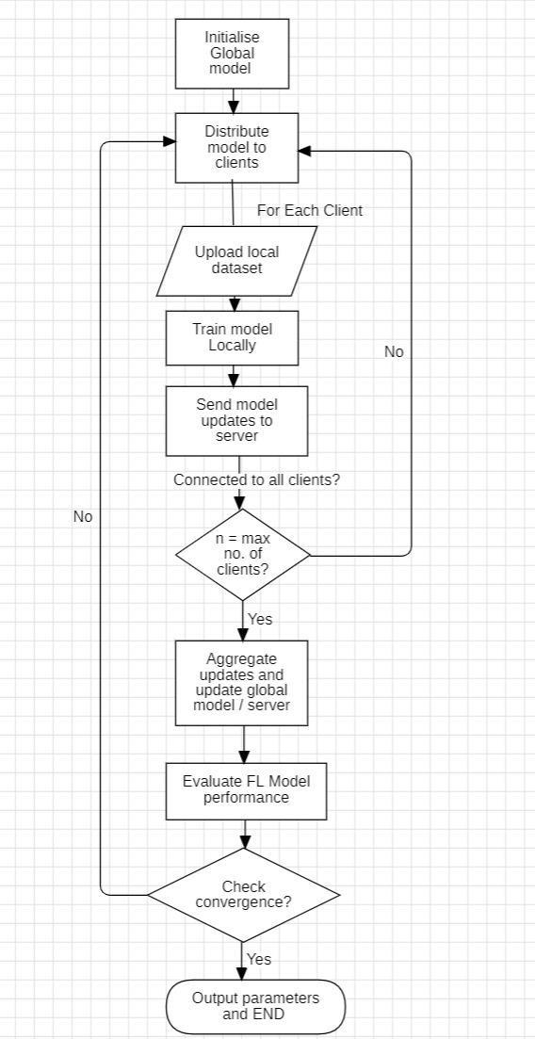
Step-by-step procedure implemented using federated learning on the ERG dataset for psychological disorder classification
Step 1: Data Collection and Preprocessing
Obtain the ERG dataset from different sources while ensuring patient data privacy and security.
Preprocess the data by normalizing the ERG signals and converting them into a suitable format for model training.(refer previous slides about this)
Step 2: Setup Federated Learning Environment
Install Required Federated learning frameworks :
Ensure you have the necessary libraries installed to run your FL code.
Flower and TensorFlow Federated (TFF) are the most popular FL frameworks available
Import Libraries: Begin by importing the required libraries.

Slide 62
Step 3: Define the Federated Learning Process
Create a Central Aggregator: Set up the server (central aggregator) which will aggregate the local updates from various clients.
Client-Side Training: Implement the suitable deep learning model training on the client side. Each client's local model will be updated using its own data.
Model Aggregation: Use the Federated Averaging (FedAvg) algorithm to aggregate the client updates at the server.
Step 4: Implement the Federated Learning Algorithm
Prepare the Dataset: Load and preprocess your ERG dataset.
Client-Side Preprocessing: Format the dataset for local client training.
Define the Model: Create the model architecture using TensorFlow.
Step 5: Train the Model
Initialize Clients: Select a small number of clients and preprocess their datasets. Define the number of clients, batch size, training & testing data division… in this section
Client-Side Training and Model Updates: Train the model on each client’s data and send the local updates to the central server.
Model Aggregation at Server: Aggregate the local updates to form a global model. Repeat the process for several rounds to improve accuracy.
Step 6: Evaluate the Model
Evaluation Metrics: Define the metrics for evaluating the model performance (e.g., loss, accuracy, ROC-AUC plots).
Evaluate on Test Data: Evaluate the global model on a test dataset to measure its performance.
Step 7: Fine-Tuning and Optimization
Hyperparameter Tuning: Adjust the hyperparameters such as learning rate, batch size, and number of communication rounds to optimize the model.
Model Optimization: Implement techniques to enhance model performance and accuracy (like Use of adam optimizer).

Slide 63
Federated Learning Workflow for ERG Data
The server and client codes implement a federated learning (FL) framework where multiple clients collaboratively train a global model on decentralized ERG (Electroretinography) data. Each client holds its own local dataset and updates the model by training locally. These updates are aggregated on the server to improve the global model over multiple epochs.

Slide 64
Server-Side Workflow
Initialize the Global Model:
The server defines a global model using PyTorch. It consists of fully connected layers for predicting mental disorders based on ERG data.
The model architecture is shared with all clients.
Client Update Management:
The server uses Flask to expose HTTP endpoints for communication with clients:
/send_model_update: Receives model updates from clients.
/get_global_model: Sends the current global model to clients.
Model Aggregation:
Once updates are received from all expected clients (app.config['expected_clients']), the server aggregates the model updates using Federated Averaging (FedAvg):
Each parameter in the global model is updated as the mean of the corresponding parameters from all client models.
This aggregation ensures that the global model learns collectively from all clients’ data without accessing the actual data directly.
Communication:
After aggregation, the updated global model is sent back to all clients for the next epoch.

Slide 65
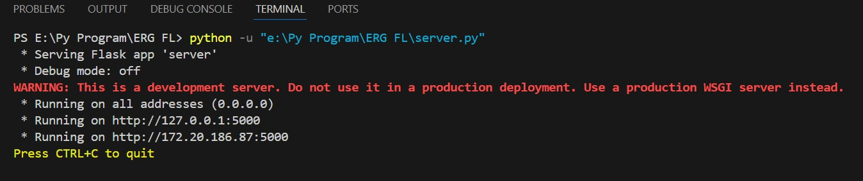
Server running…

Slide 66
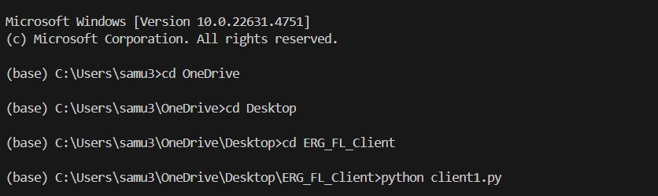
Client-Side Workflow
Data Preprocessing:
Each client preprocesses its local ERG data:
Features are normalized to ensure consistent scaling.
Labels are extracted and encoded as integers for classification.
Initialize the Local Model:
Each client initializes a local model with the same architecture as the global model.
Communication with the Server:
At the beginning of each epoch, the client requests the latest global model from the server (/get_global_model endpoint).
The client updates its local model with the global model's state.
Local Training:
The client trains its local model on its own dataset for a fixed number of epochs using stochastic gradient descent (SGD).
Training involves backpropagation and weight updates based on local data.
Model Update Submission:
After training, the client sends its updated model weights to the server via the /send_model_update endpoint.
Prediction and Evaluation:
Once training completes, the client uses the final model to make predictions on its local dataset and save the results to a CSV file.
Running Client side code with server ip address

Slide 67
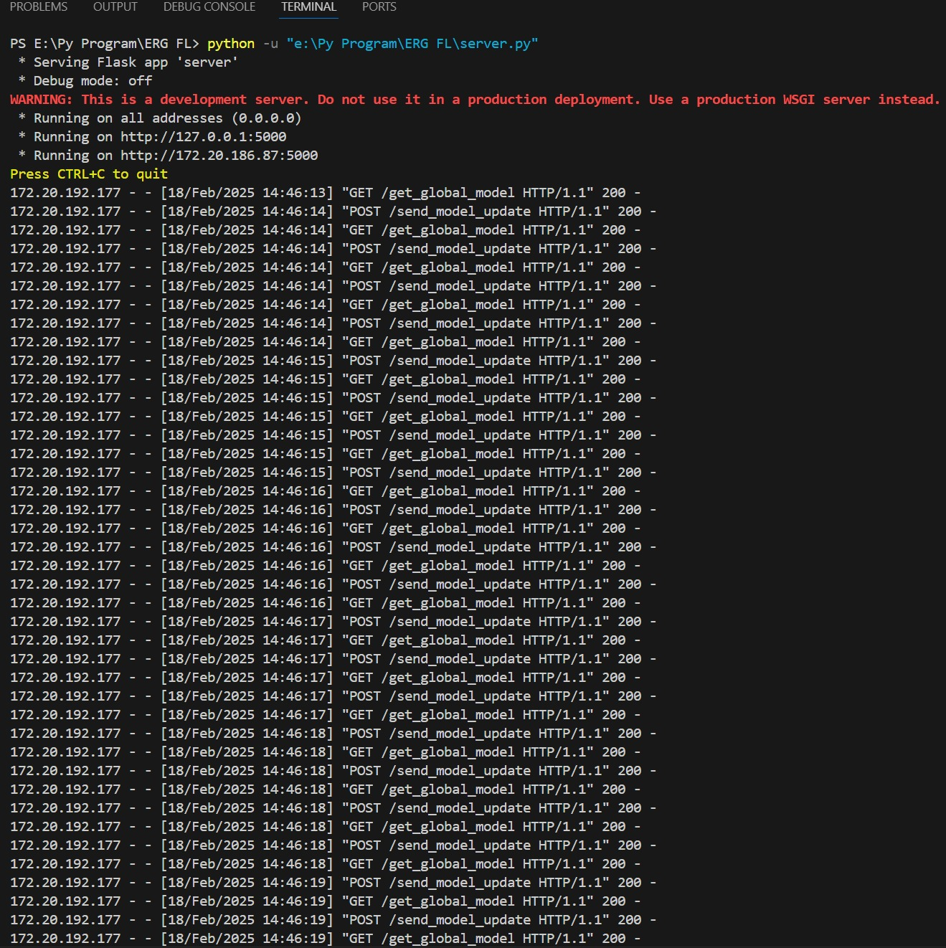
Communication Workflow
Initialization:
The server starts and waits for clients to connect.
Each client independently preprocesses its data and connects to the server.
Iteration (for each epoch):
Clients request the global model.
Clients train the local model on their data.
Clients send updated weights to the server.
The server aggregates the weights and updates the global model.
The updated global model is sent back to clients.
Server receiving request from Client.

Slide 68
Accuracy Improvement Over Epochs
Initial Model:
The initial global model is randomly initialized and has poor performance.
Accuracy is low because the model hasn't yet learned from any data.
Model Updates:
Each client's local training improves its version of the model based on its data.
Aggregating these updates allows the global model to learn generalized patterns from all clients' datasets.
Epoch-by-Epoch Improvement:
As the global model is iteratively updated and shared, it accumulates knowledge from all clients.
This leads to a gradual improvement in prediction accuracy across epochs.
Final Accuracy:
After multiple epochs, the global model converges, achieving higher accuracy on unseen data compared to any individual client model.

Slide 69
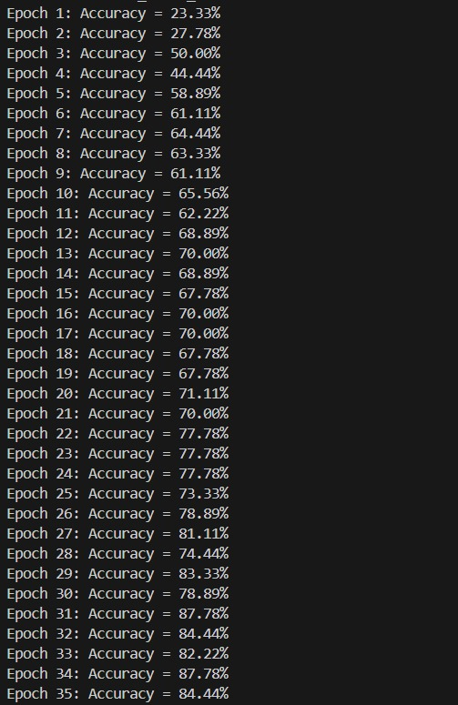
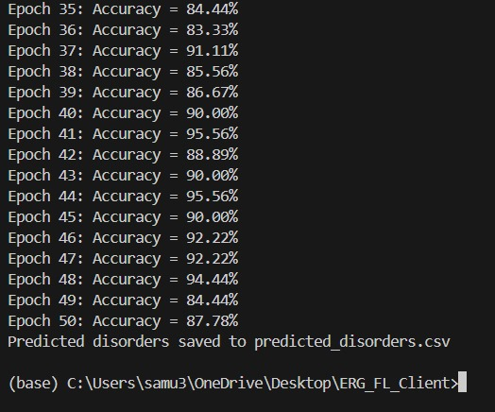
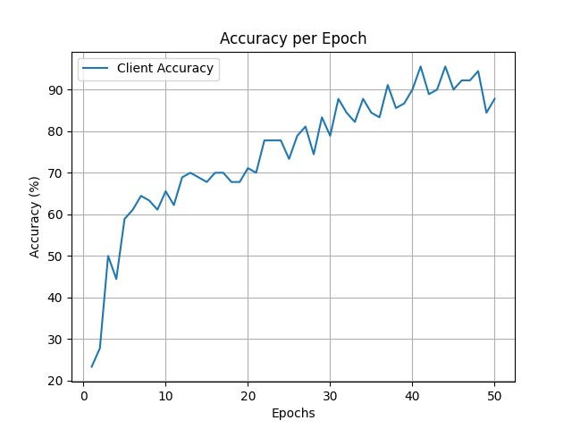
Client Side communicating with server and improving accuracy over epochs.

Slide 70
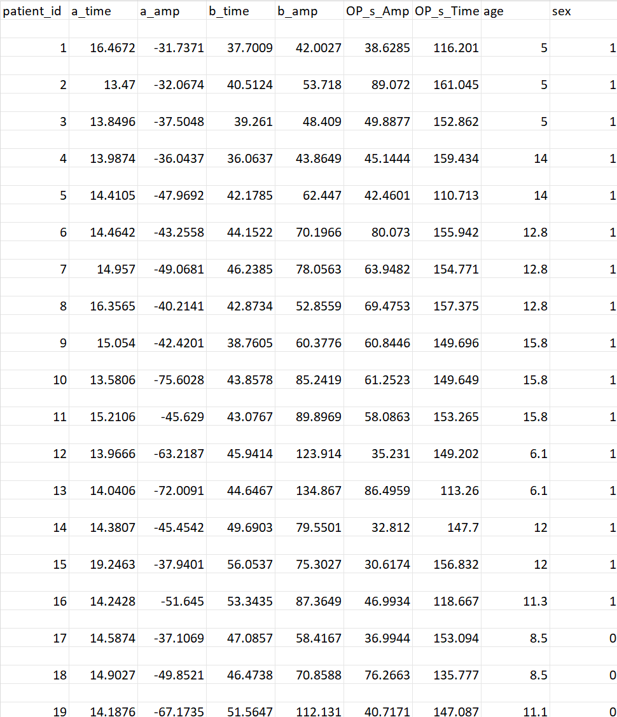
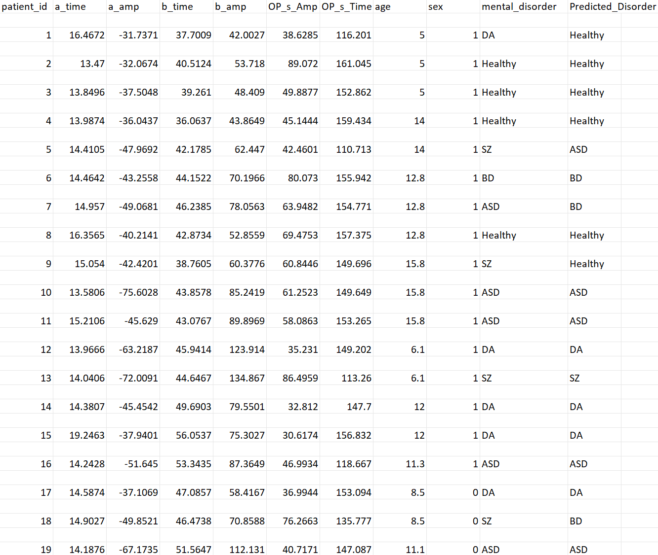
Input ERG Data by each Client with 8 input features excluding patient_id
Output dataset: Trained input data based on conditions and created target column: mental_disorder and Predicted_disorder by the FL model based on client server communication over 50 epochs

Slide 71
Key Features of the Implementation
Decentralized Data:
Data remains on client machines, ensuring privacy and security.
Only model updates are shared with the server.
Federated Averaging (FedAvg):
Aggregates model updates to improve the global model.
Scalability:
The server can handle multiple clients (adjust expected_clients).
More clients lead to better generalization as the model learns from diverse data sources.
Evaluation:
Accuracy for each epoch is computed on the local data (for clients).
Graphs show accuracy trends over epochs.

Slide 72
Benefits of Federated Learning • Data Privacy and Security: Data will never be transmitted out of the client's device; hence the data breach risk will be minimized and always in accordance with data protection policies, for instance, GDPR. • Reduced Latency: Local processing decreases time taken for access and pre-processing of data across all clients. • Personalization: Federated learning can fine-tune a global model for personal, local data, without exposure. | Applications of Federated Learning • Healthcare: Improvement in predictive models while keeping the data of the patients safe across hospitals and research centers. • Finance: Improvement in fraud detection algorithms with multiple banking data without any actual data sharing. • Mobile Applications: Training models on user devices to optimize services like keyboard suggestions, voice recognition and more | Challenges in Federated Learning • Communication Overhead: Latency and bandwidth issues in frequent communication between clients and the central server. • Heterogeneity: Local data distributions, computing power, and network conditions may be different from one another and can affect model performance. • Privacy: Federated learning improves privacy but is still vulnerable to indirect inference attacks and therefore requires further steps such as differential privacy and secure aggregation.

Slide 73
Proposed System(Phase 3) - Develop a GUI-Based Application for Federated Learning with Eye Hospitals
1. Decide the Technology Stack
Frontend (GUI): Use web frameworks like React.js, Angular, or a desktop framework like PyQt/Flask with Tkinter for simplicity.
Backend: Python-based server (e.g., Flask, FastAPI).
Database: Store hospital metadata, data logs, and model states using SQLite or PostgreSQL.
Machine Learning: Use PyTorch for model training.
2. Define Application Structure
Frontend:
Form to upload ERG data (CSV files).
Progress bar for training and prediction updates.
Display accuracy graphs and prediction results.
Backend:
Endpoints for:
Accepting client data.
Distributing and receiving models.
Sending prediction results.
Database:
Logs for received data and model versions.

Slide 74
3. Build the Backend Server
Create APIs for:
/get_global_model: Send the latest global model to clients.
/send_model_update: Accept client model updates.
/predict: Accept ERG data and return predictions.
Integrate training logic for federated learning using PyTorch.
4. Develop the Client-Side GUI
Include features:
File Upload: Allow hospitals to upload ERG CSVs.
Training Status: Show the status of federated training.
Predictions: Display disorder predictions with visualizations.
Use tools:
For web apps: React.js with Material-UI or Bootstrap.
For desktop apps: Tkinter or PyQt.
5. Implement Communication Between Client and Server
Use HTTP APIs or WebSocket for real-time updates.
Ensure proper serialization/deserialization for model updates (e.g., pickle/hex encoding).

Slide 75
6. Add Security and Authentication
Use JWT Tokens or API Keys for secure client-server communication.
Encrypt data in transit with HTTPS.
7. Deploy the Application
Deploy the server on a cloud platform like AWS, Google Cloud, or Azure.
Host the GUI on platforms like Netlify, Vercel, or a cloud server.
8. Test and Iterate
Test the app with multiple clients and validate the accuracy of predictions.
Optimize for:
Speed of communication.
Handling large datasets.
Scalability with multiple clients.
9. Maintenance and Upgrades
Add advanced features like:
Analytics dashboard for global model performance.
Real-time training progress for clients.
Integration with hospital systems (e.g., EHRs).

Slide 76
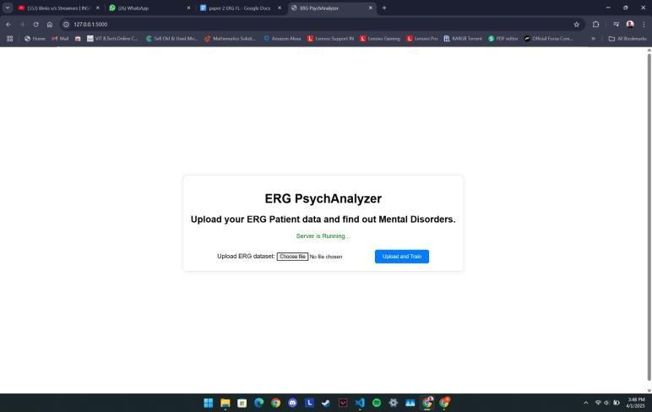
Web Application Interface
Client side simple GUI based Web Application

Slide 77
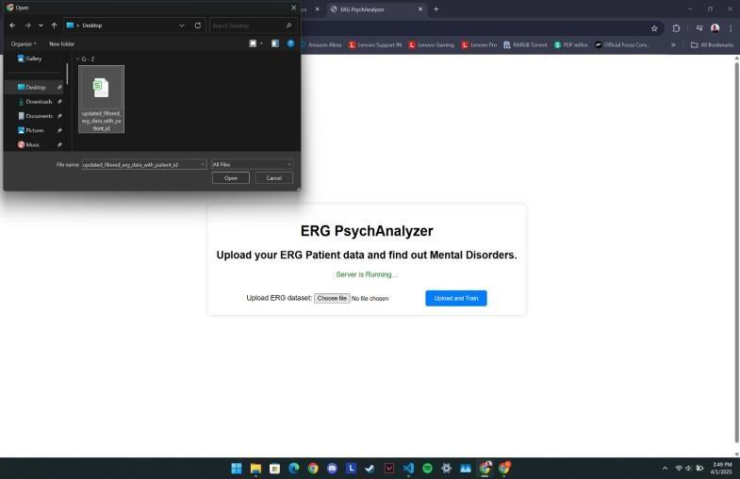
Client uploads ERG patient dataset

Slide 78

ERG patient dataset selected

Slide 79
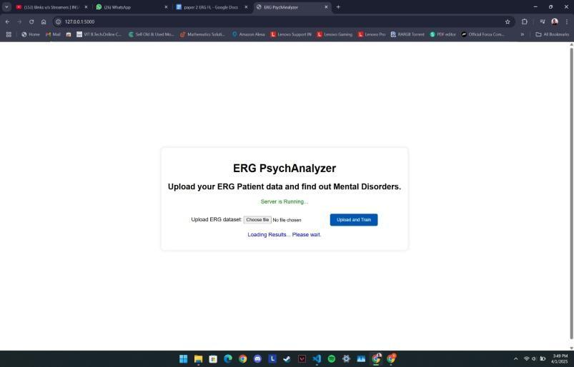
On clicking ‘Upload and Train’ Button dataset gets uploaded and client- server communication begins.

Slide 80
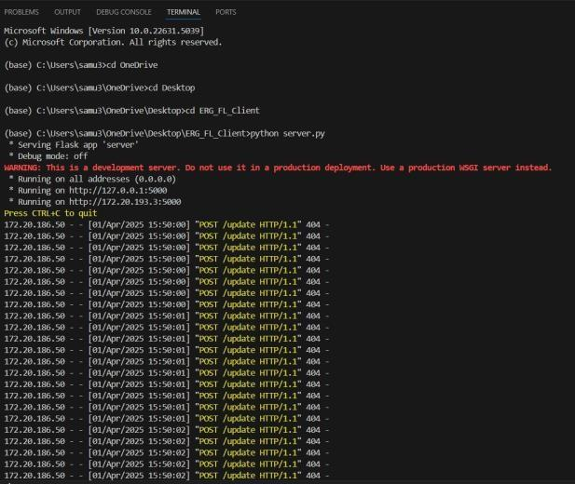
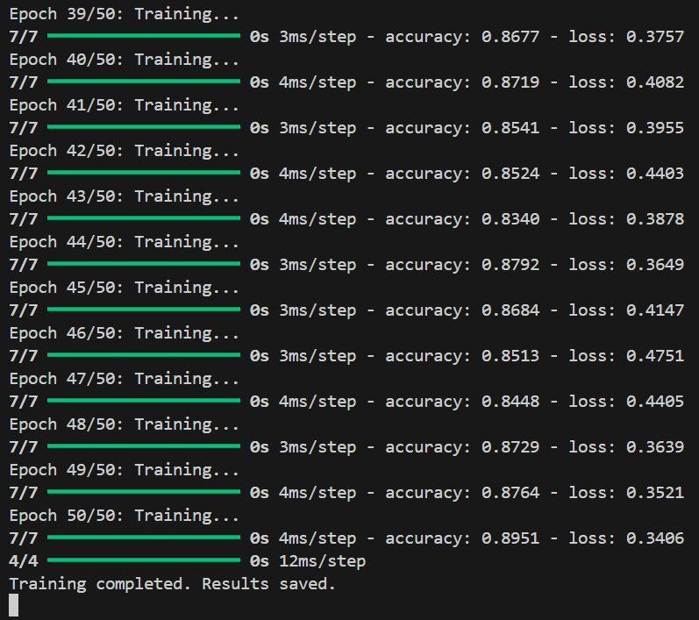
Server side machine receiving client requests.
Client side machine communicating with server side over
50 epochs and improving accuracy.

Slide 81

Accuracy graph over the epochs

Slide 82
Evaluation Metrics
 | Type of Metric | Accuracy Type
ML Models | Silhouette Score/ Davies-Bouldin Index | Clustering Accuracy
K-Means Clustering | 0.45/ 0.68 | 0.81
DBSCAN Clustering | 0.43 | 0.49
Agglomerative (Hierarchical) Clustering | 0.44/ 0.74 | 0.60
 | Train Accuracy | Test Accuracy
Random Forest | 1.00 (due to overfitting, fixed later) | 0.98
Logistic Regression | 0.797 | 0.825
DL Model | Training Accuracy | Testing Accuracy
Deep neural network (DNN) | 0.80 | 0.75
FL Model | Training Accuracy | Testing Accuracy
FedAvg | 0.93 | 0.88

Slide 83
Discussion
Electroretinography signals act as potential biomarkers for psychological disorder classification, as shown in these studies. The first study integrates machine learning and deep learning methods to recognize ERG patterns related to schizophrenia, bipolar disorder, and depression. Diagnostic accuracy is enhanced through the use of deep neural networks and implementation via the cloud; however, challenges arise due to data heterogeneity and model robustness; The second study looks to Federated Learning to address privacy issues and allow model training locally while update aggregation occurs at a central point. It retains performance on par with centralized models but is inherently secure against data revelation. Further advances in hyperparameter tuning and data collection could increase its performance. Both studies identify the trade-off among privacy, scalability, and accuracy in the context of ERG-based diagnostics, while future efforts will be on data standardization and optimization of models.

Slide 84
Conclusion
The convergence of Electroretinography and advanced methods of machine learning bears promise of a breakthrough in non-invasive and accurate diagnosis of mental disorders. The first study demonstrates deep models' capability to reliably discriminate between diseases using ERG signals; thus, there's a potential for real-time diagnosis via cloud platforms. The federated approach protects sensitive medical information from being revealed, thus settling major ethical concerns. Yet, even with such high accuracy rates, both studies place emphasis on the need for increased sample size with diversity in order to improve generalizability and robustness. Real-time analytics combined with privacy-preserving methodologies creates an interesting trajectory for development in the future toward mental health diagnosis that can yield results dismissively translated into clinical to facilitate tailored interventions.

Slide 85
Future Work
While the current configuration effectively demonstrates Federated Learning application to privacy-retained classification of psychological diseases from ERG signals, future work can focus on scaling up the dataset to represent a more heterogeneous population and other psychological diseases to generalize better. In addition, deep federated optimization techniques and adaptive learning mechanisms can give better results in terms of accuracy and efficiency of the models. Fast-tracking clinical entry may be achieved by looking into real-time ERG signal recording and edge-device support. Besides, a web application with integrated real-time analytics, multi-language support, and healthcare database integration would enhance usability and accessibility for medical professionals across the globe.

Slide 86
Research Paper Status
Research paper is completed and submitted to “IEEE Open Journal of Engineering in Medicine and Biology (OJEMB)" , 15/04/2025. (under review)

Slide 87
References
[1] Demmin, D. L., Roché, M., Davis, Q., & Silverstein, S. M. (2018). Electroretinographic Anomalies in Schizophrenia. Journal of Abnormal Psychology, 127(4), 417-428. [2] Cabrera DeBuc, D., Somfai, G. M., Arthur, E., Kostic, M., Oropesa, S., & Mendoza Santiesteban, C. (2018). Investigating Multimodal Diagnostic Eye Biomarkers of Cognitive Impairment by Measuring Vascular and Neurogenic Changes in the Retina. Frontiers in Physiology, 9:1721. [3] Cabrera DeBuc, D., Feuer, W. J., Persad, P. J., Somfai, G. M., Kostic, M., Oropesa, S., & Mendoza Santiesteban, C. (2020). Investigating Vascular Complexity and Neurogenic Alterations in Sectoral Regions of the Retina in Patients With Cognitive Impairment. Frontiers in Physiology, 11:570412. [4] Kazakos, C. T., & Karageorgiou, V. (2020). Retinal Changes in Schizophrenia: A Systematic Review and Meta-analysis Based on Individual Participant Data. Schizophrenia Bulletin, 46(1), 27-42. [5] Constable, P. A., Ritvo, E. R., Ritvo, A. R., Lee, I. O., McNair, M. L., Stahl, D., Sowden, J., Quinn, S., Skuse, D. H., Thompson, D. A., & McPartland, J. C. (2020). Light-adapted electroretinogram differences in Autism Spectrum Disorder. Journal of Abnormal Psychology, 127(4), 417-428. [6] Lavoie, J., Maziade, M., & Hébert, M. (2014). The brain through the retina: The flash electroretinogram as a tool to investigate psychiatric disorders. Progress in Neuro-Psychopharmacology & Biological Psychiatry, 48, 129-134. [7] Hébert, M., Mérette, C., Paccalet, T., Gagné, A.-M., & Maziade, M. (2017). Electroretinographic anomalies in medicated and drug-free patients with major depression: Tagging the developmental roots of major psychiatric disorders. Progress in Neuro-Psychopharmacology & Biological Psychiatry, 75, 10-15. [8] Silverstein, S. M., & Rosen, R. (2015). Schizophrenia and the eye. Schizophrenia Research: Cognition, 2, 46-55. [9] Peredo, R., Hébert, M., & Mérette, C. (2022). Developing a clinical decision tool based on electroretinogram to monitor the risk of severe mental illness. BMC Psychiatry. [10] Demmin, D. L., Roché, M., Davis, Q., & Silverstein, S. M. (2018). Electroretinographic Anomalies in Schizophrenia. Journal of Abnormal Psychology, 127(4), 417-428. [11] Alaql, A. M. (2016). Analysis and Processing of Human Electroretinogram. USF Tampa Graduate Theses and Dissertations [12] Khalil, S. S., Tawfik, N. S., & Spruit, M. (2024). Exploring the potential of federated learning in mental health research: a systematic literature review. Applied Intelligence, 54(2), 1619-1636. [13] Hallaj, S., Chuter, B. G., Lieu, A. C., Singh, P., Kalpathy-Cramer, J., Xu, B. Y., Christopher, M., Zangwill, L. M., Weinreb, R. N., & Baxter, S. L. (2025). Federated Learning in Glaucoma: A Comprehensive Review and Future Perspectives. Ophthalmology Glaucoma, 8(1), 92-105. [14] Xu, J., Glicksberg, B. S., Su, C., Walker, P., Bian, J., & Wang, F. (2021). Federated learning for healthcare informatics. Journal of Healthcare Informatics Research, 5, 1-19. [15] Kumar, Y., & Singla, R. (2021). Federated learning systems for healthcare: perspective and recent progress. Federated Learning Systems: Towards Next-Generation AI, 141-156. [16] Thummisetti, B. S. P., & Atluri, H. (2024). Advancing healthcare informatics for empowering privacy and security through federated learning paradigms. International Journal of Sustainable Development in Computing Science, 6(1), 1-16.

